Slide 1
Website Members’ Area www.ethicspros.com contact@ethicspros.com Sue Egan / Thomas Hauser

Slide 2
Levels of Access
The new Members’ Area can have up to 5 access levels (more if we pay a fee)
Members of each access level can see all information for their level and all previous levels
Can set “update” rights separately from “read” rights to keep content safe
Proposal for different levels on next slide

Slide 3
Levels of Access
The new Members’ Area has 4 access levels:
Level 0 | Level 1 | Level 2 | Level 3
Guests (free registration) | Members (who have paid their subscription) | Working Group Members | Strategic Committee & Board Members
Content that anyone who subscribes can see | Content that “paid-up” and honorary members can see | All Working Group Members can see content for all WGs | Content for SC & Board members, including agendas, minutes, etc.
Useful teaser information to encourage membership | Content, address book, ability to contact other members | Private area for Working Group members to share & develop ideas | Private area for Board & Strategic Committee to share thoughts on strategic direction and Working Group ideas

Slide 4
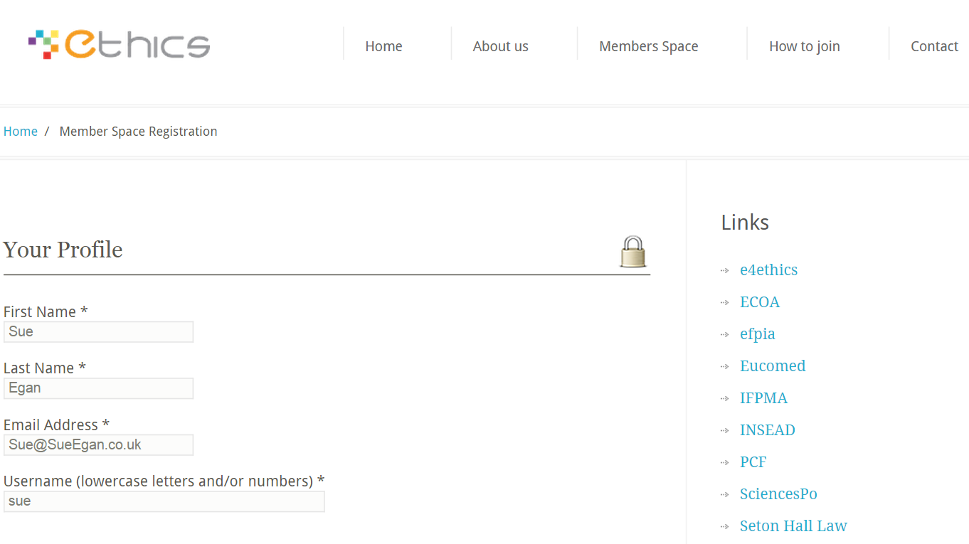
Sample Registration Screen

Slide 5
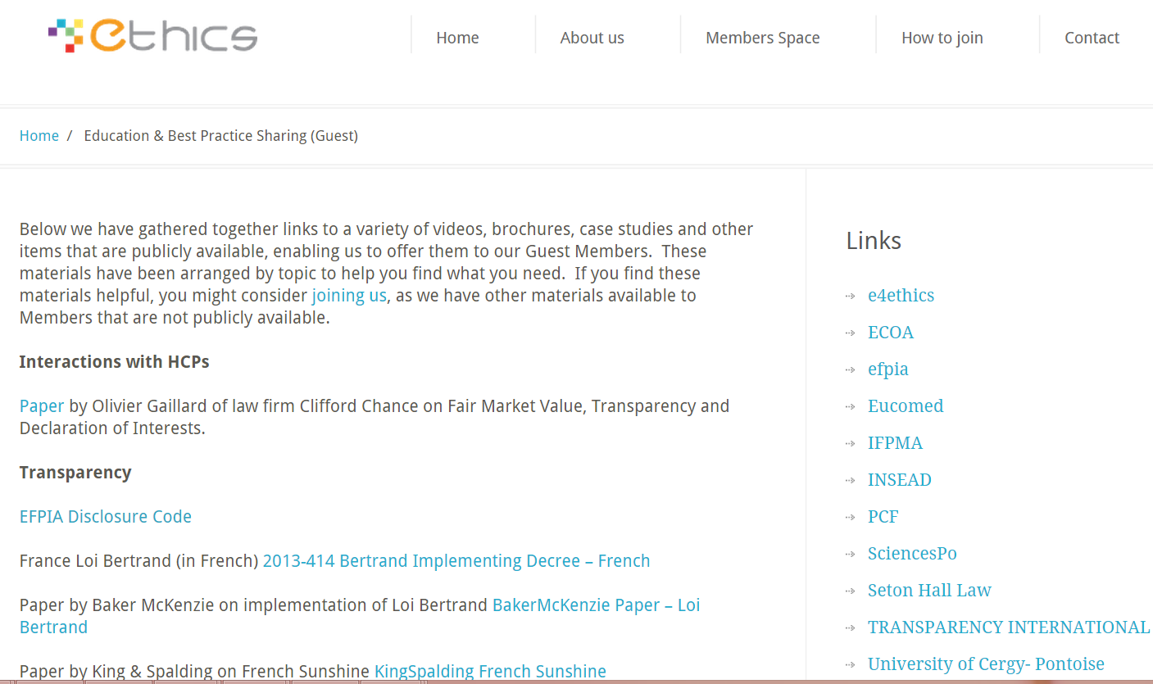
Sample Guest Content

Slide 6
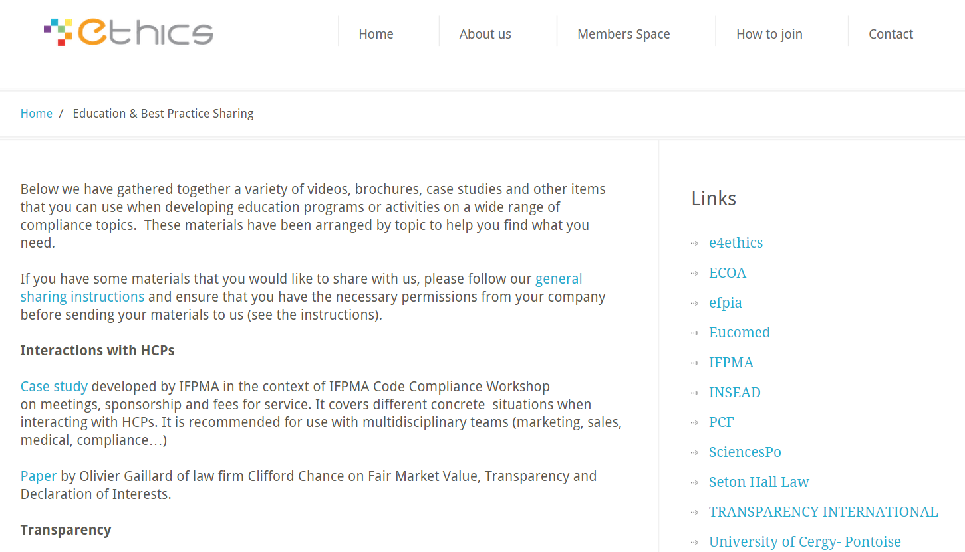
Sample Member Content

Slide 7
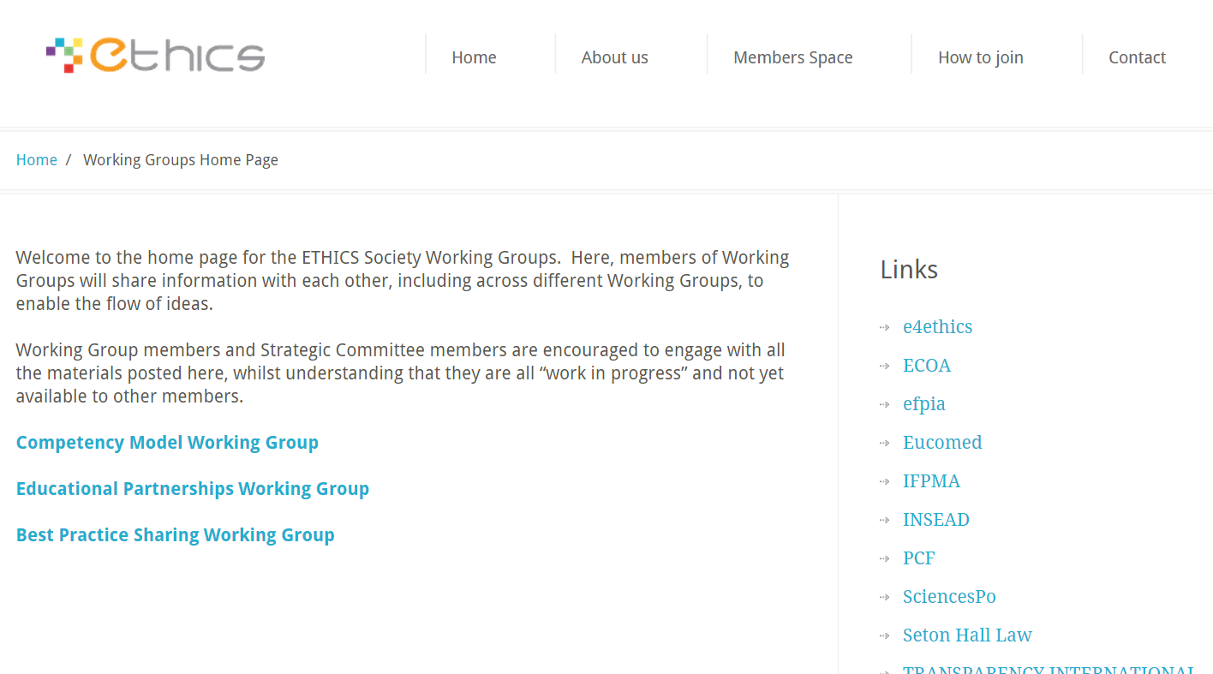
Sample Working Group Content

Slide 8
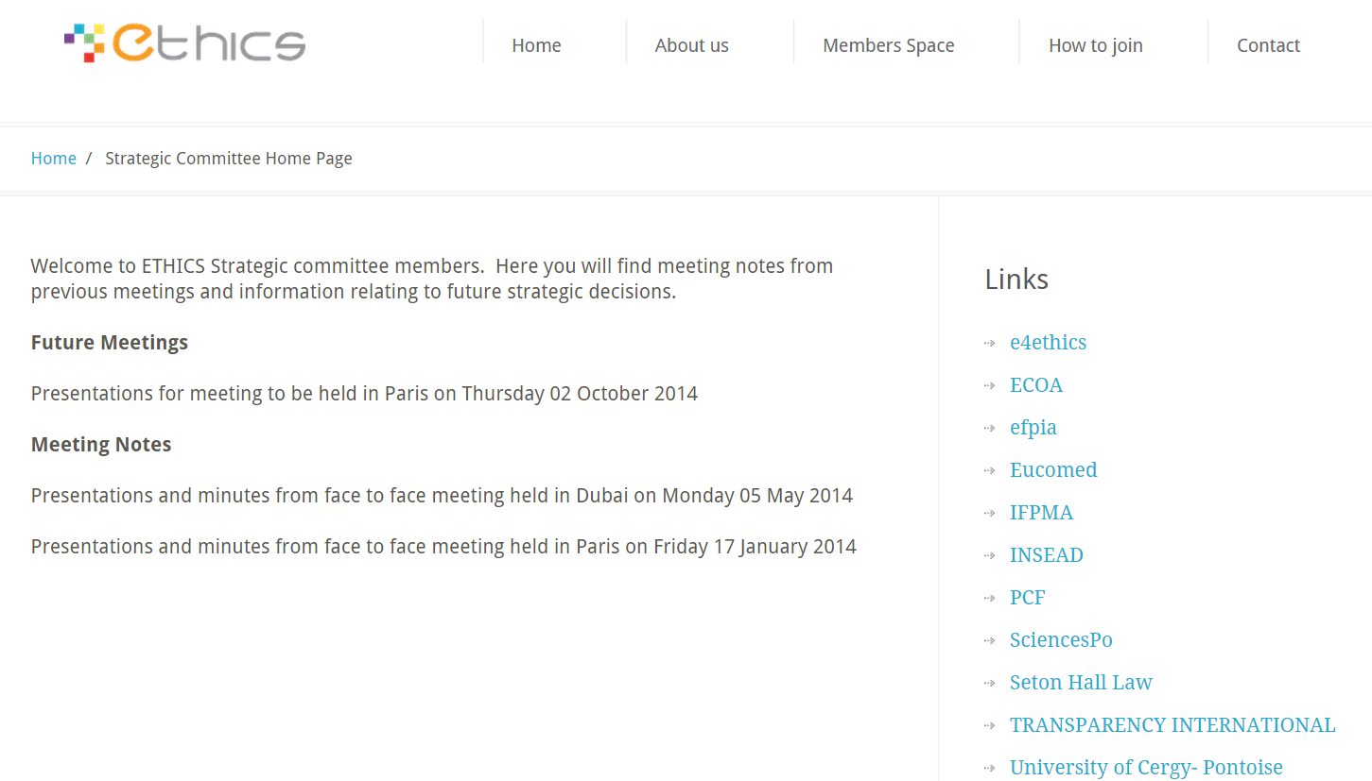
Sample Strategic Committee Content

Slide 9
www.ethicspros.com contact@ethicspros.com
Questions?

