Slide 1
Website Update www.ethicspros.com contact@ethicspros.com Sue Egan

Slide 2
Website General Progress Update
All current members have access to the Members’ Space (more later)
Website hosting has now been fully migrated to our new provider
Gives us greater control over the site
We can now set up additional email addresses as needed, e.g. Treasurer@ethicspros.com, which can be forwarded to Pascale
We can now review website statistics (not previously possible)
The Contact and Application forms on the website have been reactivated, and are now working
Two applications received via the website form since migration
Migration required a “password reset” for all members – new passwords and emails generated via website
Almost no feedback received on website since migration

Slide 3
Members’ Space update
Membership levels implemented as:
1 = Member
2 = Working Group Member
3 = Strategic Committee Member
4 = Board Member
Pages have been set up to cater for each level, and are being populated gradually
More information will be added to the Best Practice Sharing area this weekend
Some feedback received:
Missing documents on Best Practice Sharing (see above)
Some dates needed updating for Seton Hall / Sciences Po

Slide 4
Online Payments Update
ETHICS PayPal account is set up ☺
ETHICS website is configured to accept payments via PayPal ☺
To use the on-line payment method, members must either already have, or must set up, a PayPal account ☹
Once the option has been chosen, and the “Subscribe” button pressed, members are taken to PayPal France, where all the information is displayed in French ☹
Set-up has taken much longer than anticipated and is not yet fully tested ☹
Information returned via PayPal to the website will reduce the overall administrative burden ☺
Suggestion – trial on-line payments for a few Strategic Committee members before opening up to general membership

Slide 5
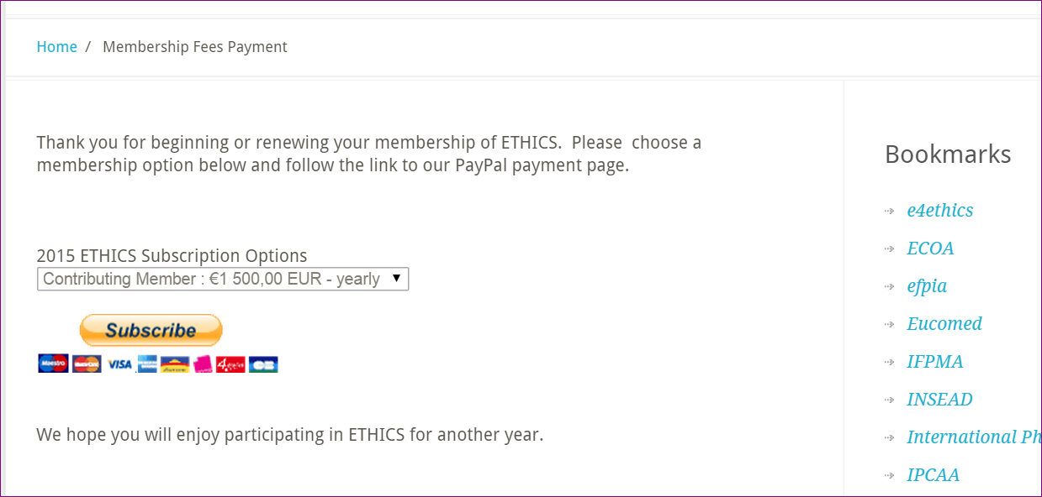
Online Payment Screenshots

Slide 6
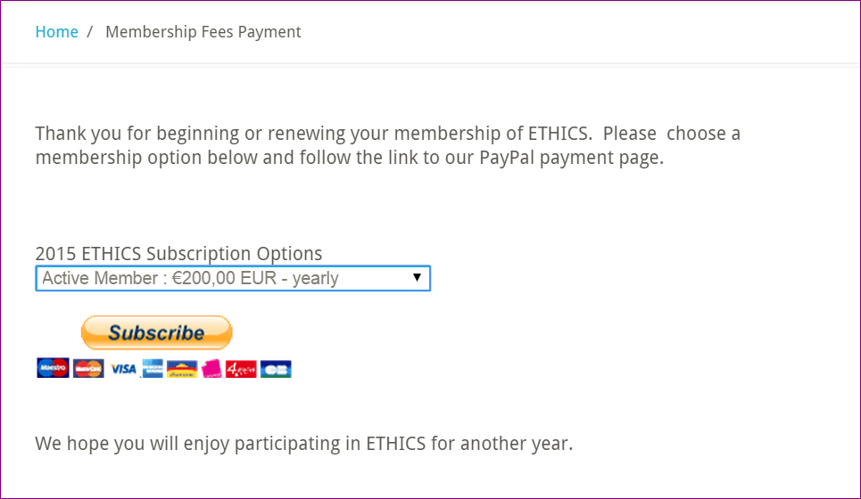
Online Payment Screenshots

Slide 7
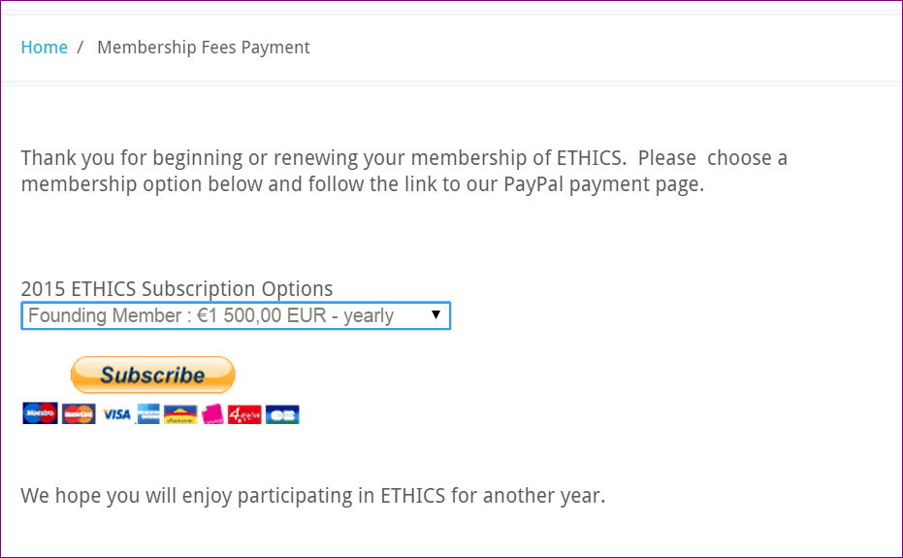
Online Payment Screenshots

Slide 8
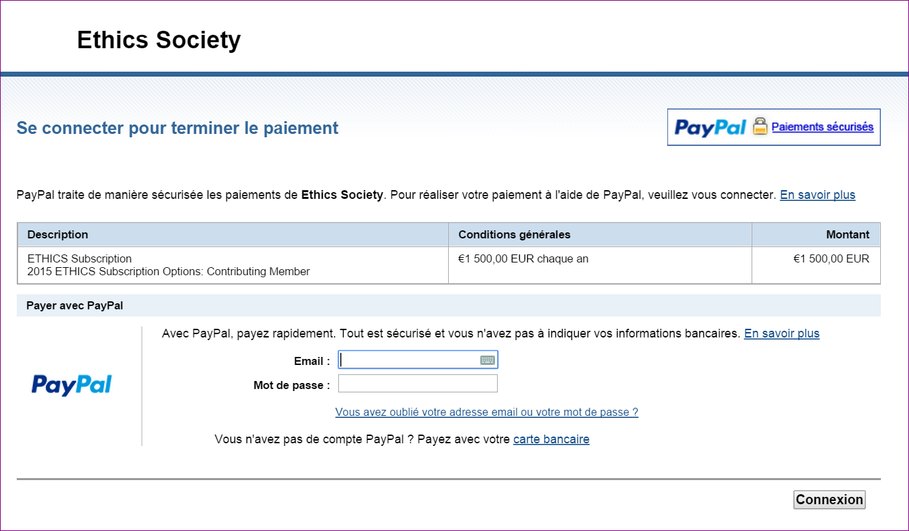
Online Payment Screenshots

Slide 9
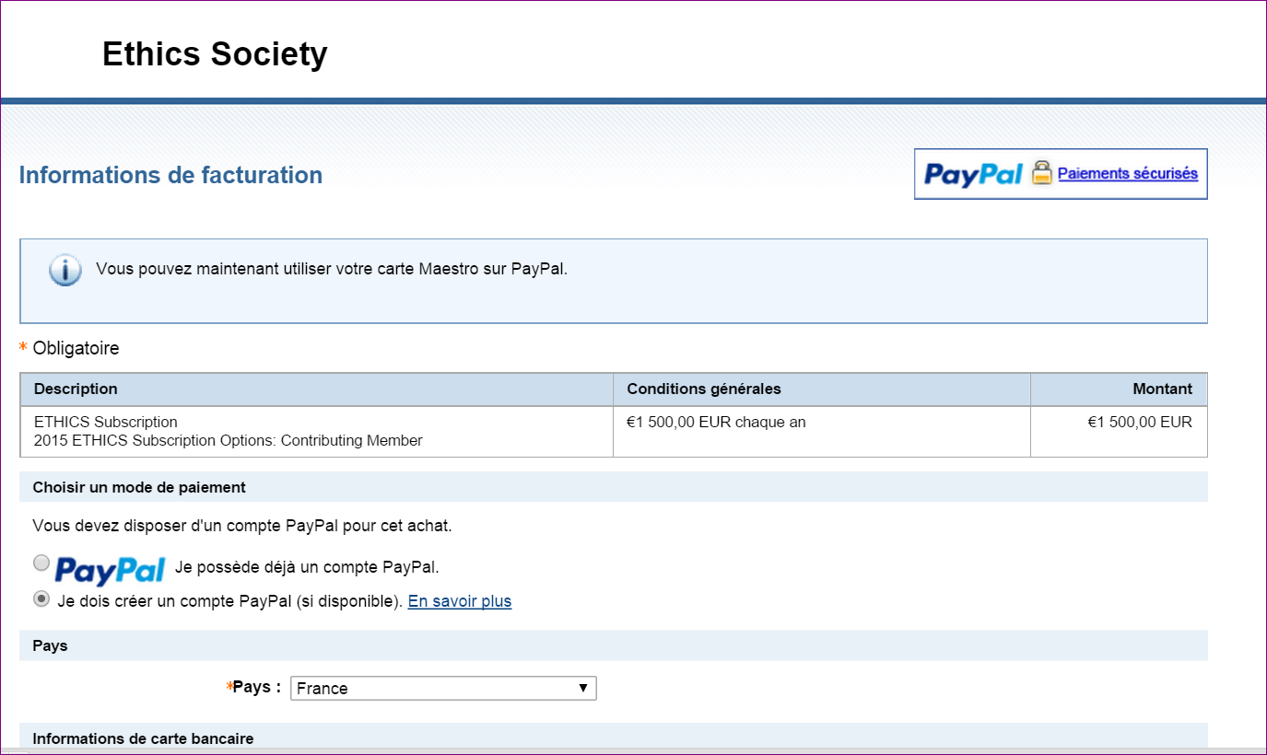
Online Payment Screenshots

Slide 10
Website Next Steps
Extend testing of on-line payments to include a few Strategic Committee Members – volunteers please!
Add all remaining materials to Best Practice Sharing pages and correct the broken IFPMA link
Consider changes to home page to make it less static
Train Maryline to add / maintain information on the website
Populate Strategic Committee and Board pages with meeting information

Slide 11
www.ethicspros.com contact@ethicspros.com
Questions?

