Slide 1
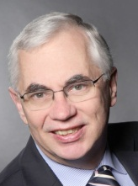
Healthcare Ethics & Compliance Competency Model
Working Group
Members
Katalin Pungor, Tamara Tubin, Sue Egan, Andy Gascard
Webex session 13 July 2017

Slide 2
Healthcare Ethics and Compliance Competency Model
Content owned by ETHICS. Members may use materials for their personal development, or for any not-for-profit activity within their employing organisation. All other rights reserved.

Slide 3
Vision: Healthcare Compliance (HCC) Professional facilitates regaining and sustaining of stakeholder, governmental and public trust of Health Care/Life Science Industry as valuable partner in finding treatment solution for patients
Mission: HCC Professional advances and promotes culture of business accountability of ethical business decision making with a focus on mitigating risks of non-compliance
Strategic Pillars of the HCC Professional Function
STRATEGIC PARTNER To get alignment on ethical behavior, integrity and transparency | CHANGE MANAGER | COMPLIANCE LEADER/ADVISOR Leading by example & without authority
For internal stakeholders/business leaders understands business strategy and market trends aligns on present and future compliance risks related to their business advises business leaders on compliant business solutions, including changes tobusiness models facilitates development of compliance SWOT/strategy fosters candid discussions on business compliance fosters adequate actions in case of incidents For external stakeholders either via supporting/advising the relevant business representative and/or via active personal participation policy makers’ groups (e.g. industry associations) | Facilitates re-positioning of the compliance function “from policing to business partnering” (if needed, if not: ensures the value based positioning) Facilitates competency development for compliant business if needed based on insight into business decision making and customer facing interactions Fosters business accountability Translates HCC into business benefits fosters emotional identification around values | Acts as a role model for compliance and a visionary, inspires and motivates stakeholders Embeds compliance requirements in a simple, easy to understand way into business processes Monitors / tests adherence to compliance programs/local rules and regulations as part of risk assessment, Informs stakeholders / business leaders and ensures relevant actions are taken Leads/facilitates cooperation across different functions to align on compliant and ethical business standards / competencies / strategies / resources / communication
© 2016 ETHICS Society
Content owned by ETHICS. Members may use materials for their personal development, or for any not-for-profit activity within their employing organisation. All other rights reserved.

Slide 4
HCC Professional Core Competencies v2.0
Strategic partner | Change manager | Compliance leader/advisor
Strategic skills Business acumen, understand and develop strategy (analytical skills, synthesis), planning, seeing hidden problems, differentiating between facts and assumptions, understanding the context/big picture, aligning on & ensuring compliance controls in business processes Stakeholder management (internal & external) understanding and impacting decision making, networking, connecting / bridging, customer orientation, strategic alliance, organizational intelligence, working in teams, sensitivity for multicultural aspect Governance understand and become part of the governance structure, keep independence | Communication skills listening, asking the right questions, assertive communication, presentation skills, negotiation skills, identifying & managing manipulative communication /hidden agendas Impact/influencing skills selling skills, identifying / managing body language, engagement, coaching, conflict management, manage difficult discussions Project management skills stakeholder & resource management, alignment, implementation | Leadership skills - leading without authority self-confidence / courage, self awareness, motivate & inspire, delegate & empower, ability to receive & give appropriate feedback, making decisions, managing complexity & ambiguity, facilitate development of company competencies, ability to learn & adapt, develop oversight Ethical role model - leading by example being open / approachable, patience & resilience, integrity & reliability, accountability, walk the talk, learn & facilitate learning from mistakes
Personal skills Self management: prioritization, stress management, work-life balance Positive attitude: celebrating success (self & team), sense of humour Use of common sense
Content knowledge (experience & training)
Non-HCC knowledge: business strategy / process / systems, budget planning, finance for non-finance
HCC knowledge: HCC strategy / processes / systems, monitoring/testing/auditing, regulatory environment
HCC= Healthcare Compliance
Content owned by ETHICS. Members may use materials for their personal development, or for any not-for-profit activity within their employing organisation. All other rights reserved.

Slide 5
Self Assessment Tool Objective
To provide a simple, easy to use, flexible tool based on the agreed competency model
For assessment purposes:
o for self-assessment
o for giving feedback by the line manager
o for collecting feedback from stakeholders
For agreement on development areas:
o proposal is to select the areas of improvement / strength
o as a general rule select max. 3 based on what could best contribute to performance improvement / enhancement and / or career development
remember that one should not only focus on the improvement areas but also on the areas of strength
Thank you for the core group testing & feedback:
Enno Behrendt, Nys Vincent, Giota Papamarkou
And for feedback and input received during and after the General Assembly 2016, including from Hubertus Stockmann
Content owned by ETHICS. Members may use materials for their personal development, or for any not-for-profit activity within their employing organisation. All other rights reserved.

Slide 6
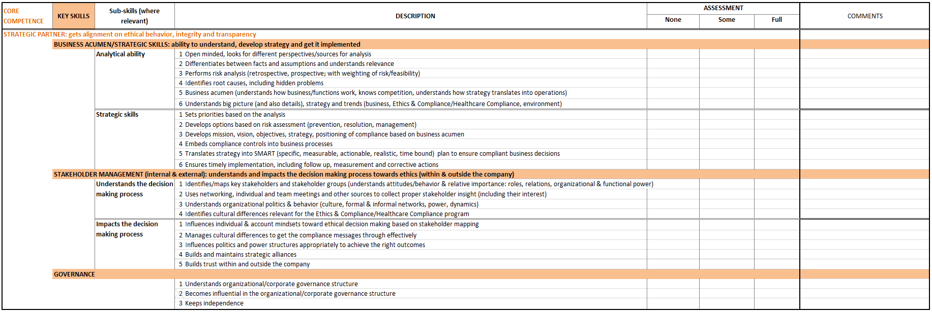
Self Assessment Tool Structure
5 tabs: 4 for Core Competencies (Strategic partner, Change manager, Compliance lead, Personal)
1 for Content knowledge
same coloring as in the model PowerPoint (orange, grey)
Content per sheet:
key skills (sub-skills as relevant)
short description of indicators of competence level in key skills (sub-skills)
simple assessment options (none, some, full) with comment opportunity
Content owned by ETHICS. Members may use materials for their personal development, or for any not-for-profit activity within their employing organisation. All other rights reserved.

Slide 7
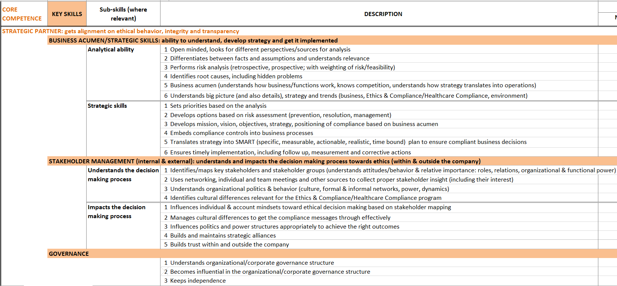
Self Assessment Tool Strategic Partner
Content owned by ETHICS. Members may use materials for their personal development, or for any not-for-profit activity within their employing organisation. All other rights reserved.

Slide 8
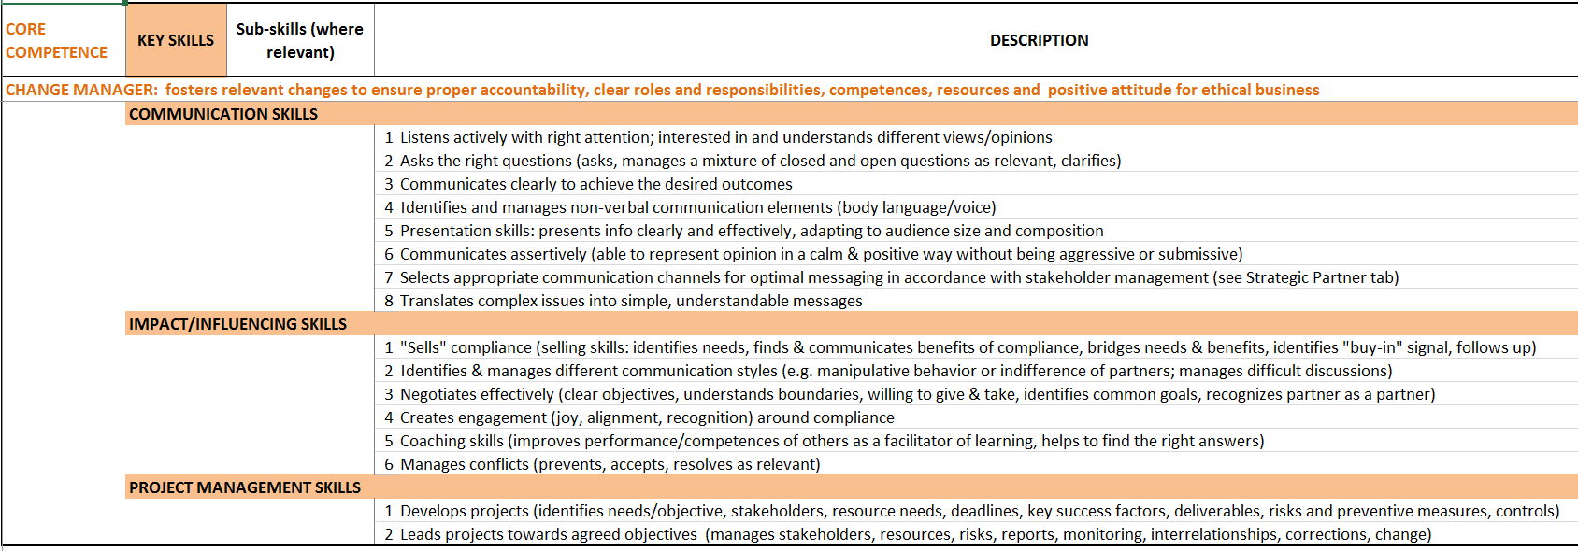
Self Assessment Tool Change Manager
Content owned by ETHICS. Members may use materials for their personal development, or for any not-for-profit activity within their employing organisation. All other rights reserved.

Slide 9
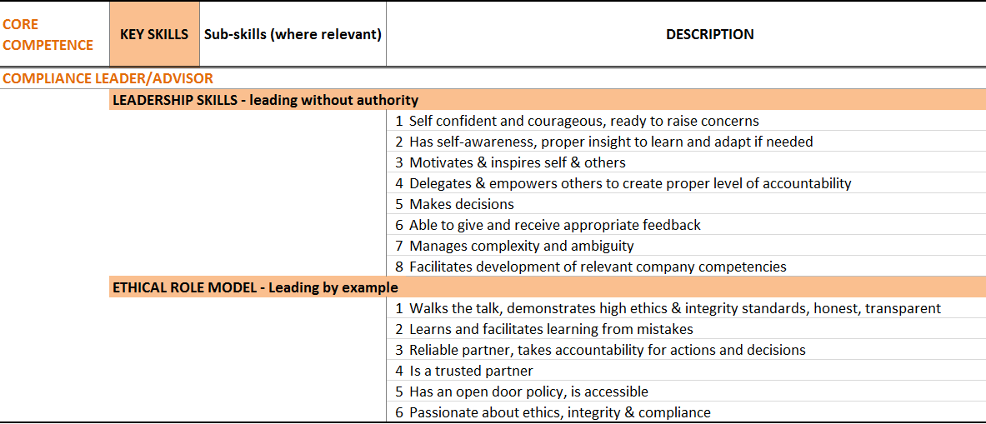
Self Assessment Tool Compliance Lead/Advisor
Content owned by ETHICS. Members may use materials for their personal development, or for any not-for-profit activity within their employing organisation. All other rights reserved.

Slide 10
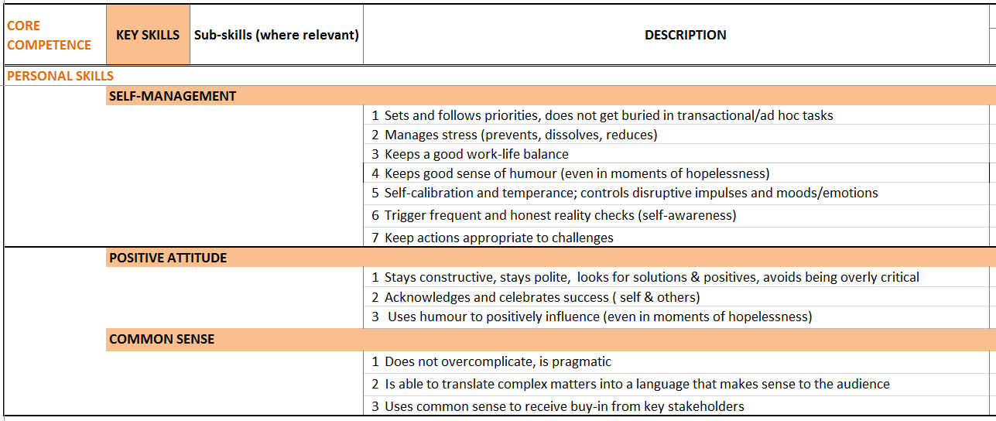
Self Assessment Tool Personal Skills
Content owned by ETHICS. Members may use materials for their personal development, or for any not-for-profit activity within their employing organisation. All other rights reserved.

Slide 11
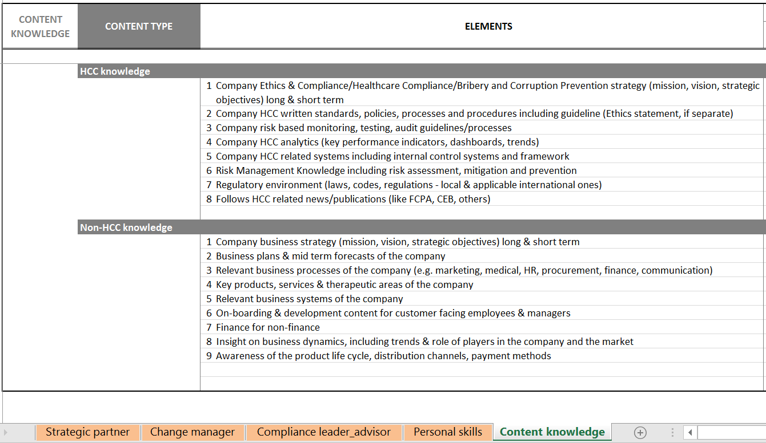
Self Assessment Tool Content Knowledge
Content owned by ETHICS. Members may use materials for their personal development, or for any not-for-profit activity within their employing organisation. All other rights reserved.

Slide 12
Actions agreed at the General Assembly 2016 – status overview
Develop a Communication Plan & Strategy
Consolidate feedback on Self-Assessment Tool
Finalize Self-Assessment Tool
Endorsement from ETHICS Strategic Committee & Bureau
Webinar Sessions with Q&As – now
Website Update
- Healthcare Ethics & Compliance Competency Model next version
Content owned by ETHICS. Members may use materials for their personal development, or for any not-for-profit activity within their employing organisation. All other rights reserved.

