Slide 1
Guiding Cultural Change in Compliance and Ethics
Beatrice Bauer
SDA Bocconi School of Management

Slide 2
How can we move as a function/profession from simple “influencers without authority” to “cultural game changers”?

Slide 3
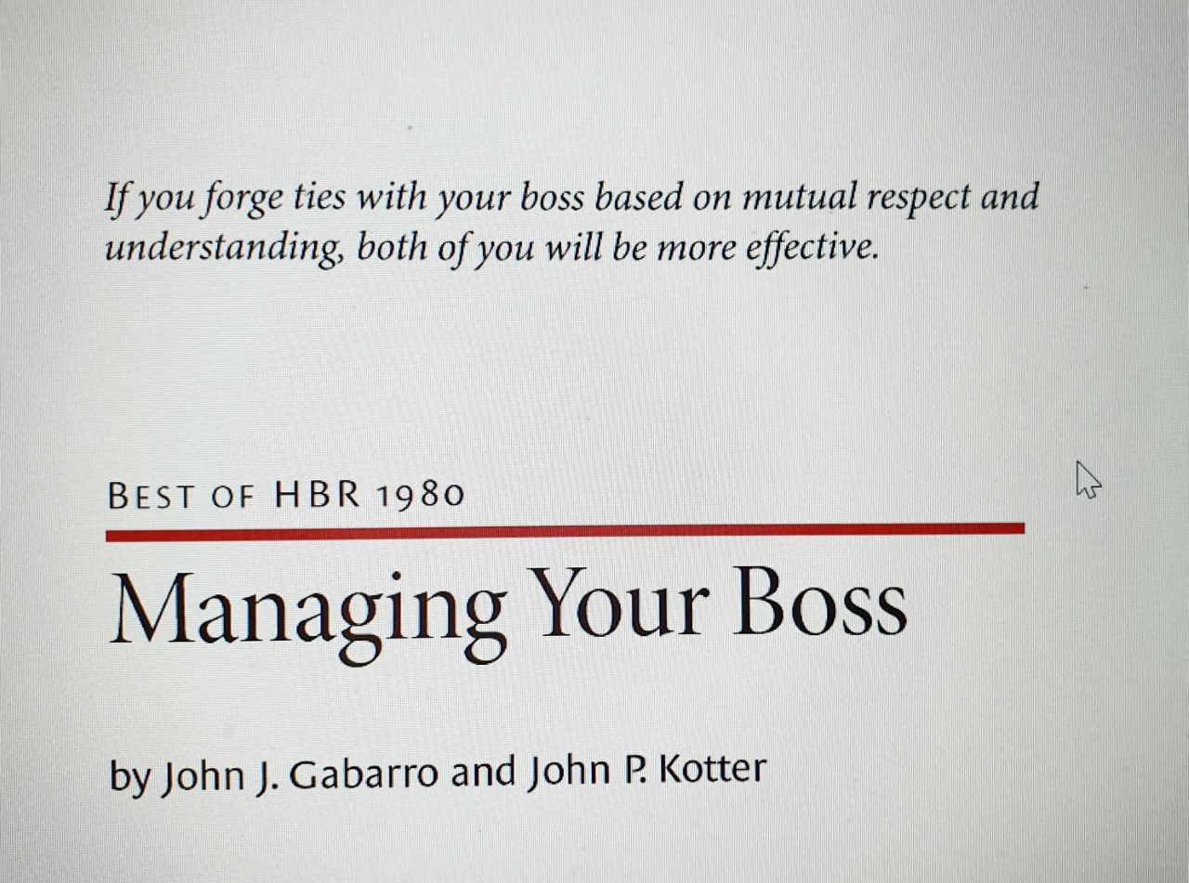
In shifting from a culture that is satisfied with the status quo to one that is ready to change, the “fire in the belly”- needed to bring about change - has to start at the top
How to Implement Change in Practice, Gesman D, Minnesota Oncology, Minneapolis, MN; Wiseman M, Wiseman Communications, Washington, DC Copyright © 2010 by American Society of Clinical Oncology
Notes:
Have visible proponents. For culture change to stick, it must be a priority of the CEO and board of directors.
Don’t rush it. Changing a culture can take anywhere from months to several years.
Problems of Power strategies and power bases

Slide 4
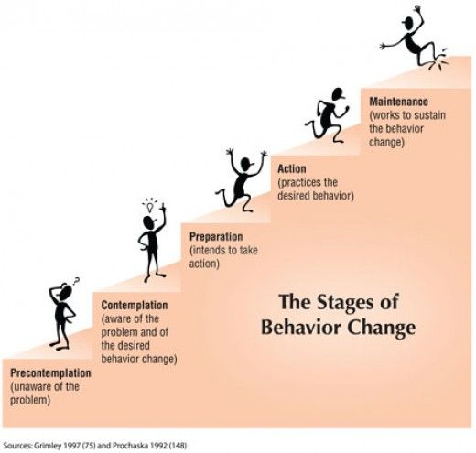
Creating dissatisfaction with the current situation
Increase the perception of the risks and problems that the current behavior entails.
Insinuate doubts with a neutral description of risks and problems
Notes:
Show the board a framework for understanding organizational culture and its impact on compliance and ethics

Slide 5
“Takes more than a license for a gun…”
Sting
Notes:
Problems of Power strategies and power bases

Slide 6
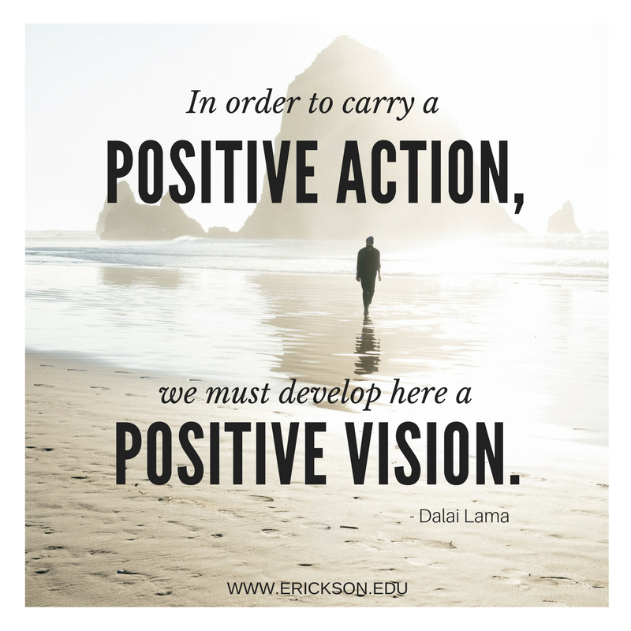
You need a positive vision of the future
A vision is a picture or idea you have in your mind of yourself, your business, or anything which is going to happen. A clear vision helps you pursue dreams and achieve goals; an idea of the future, a strong wish. ...
Notes:
Importance of a model, vicarious learning, show the need for change, generative metapher

Slide 7
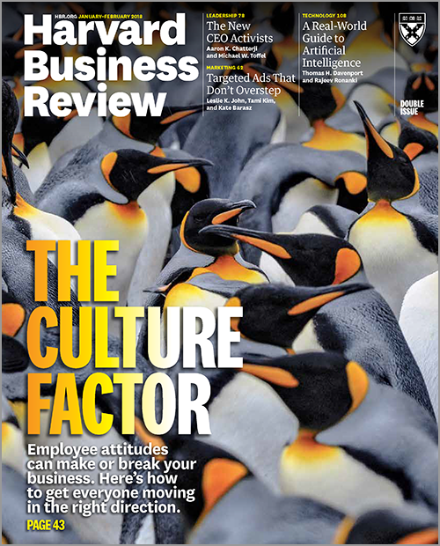
Defining Culture
Cultural norms define what is
encouraged, discouraged, accepted,
or rejected within a group.
When properly aligned with personal values, drives, and needs, culture can unleash tremendous amounts of energy toward a shared purpose and foster an organization’s capacity to thrive.
The Leader’s Guide to Corporate Culture, B Groysberg, J Lee, Y Cheng, 2018

Slide 8
A Dynamic Definition of Culture
The culture of a group can be defined as the accumulated shared learning of that group as it solves its problems of external adaptation and internal integration, which has worked well enough to be considered valid …
Edgar Schein, Organizational Culture and Leadership, Wiley, 2017

Slide 9
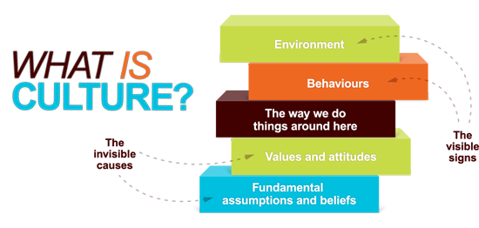
Culture is the tacit social order of an organization: It shapes attitudes and behaviors in wide-ranging and durable ways.
That is, culture rests on deep, often unnoticed sets of assumptions.

Slide 10
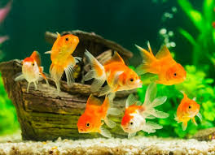
Notes:
The only who don’t know what water is, are the fish! “Change your thoughts, and you will change the world” Norman Vincent Peale

Slide 11

There are rarely individuals who can burst in from the outside and disrupt things. This might sound appealing to the would-be heroes among us, but such individuals are unlikely to possess the credibility to sustain any commitment .
Notes:
Managing ideas does not mean impose one's ideas, but on the contrary, it means creating the psychological and organizational conditions so that people can produce initiatives and ideas useful for solving problems.

Slide 12
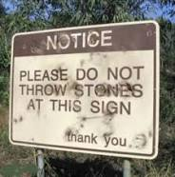
Reactance is an unpleasant motivational arousal (reaction) to persons, rules, or regulations that threaten or eliminate specific behavioral freedoms.
Reactance occurs when a person feels that someone or something is taking away their choices or limiting the range of alternatives.

Slide 13
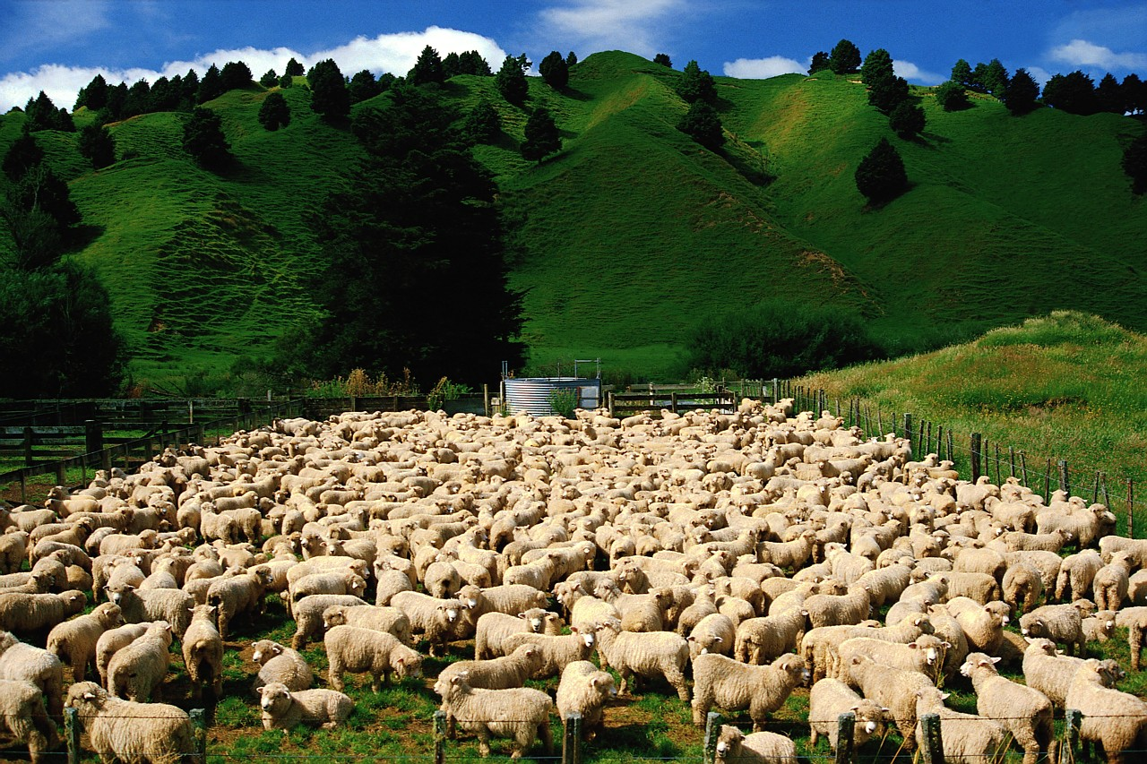
“If you put fences around people, you get sheep.”
William L. McKnight, 1924
Notes:
Milgram

Slide 14
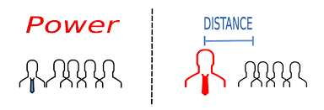
DIFFERENT PERCEPTIONS OF HIERARCHY
HIGH POWER DISTANCE Culture
These are cultures in which the power relations are paternalistic and autocratic, and where there is centralized authority. In other words, there is a wide gap of emotional distance
which is perceived to exist among people at different levels of the hierarchy.

Slide 15

People “buy-in”…
because you have
somehow connected
with them personally…
R Goffee, G Jones, Why Should Anyone be led by you? HBSP 2006

Slide 16
THE NEUROSCIENCE OF TRUST PAUL J. ZAK
Harvard Business Review Jan/Feb. 2017
It’s not about being easy on your employees or expecting less from them. High trust companies hold people accountable but without micromanaging them. They treat people like responsible adults.

Slide 17
Different factors in change processes
Success
Collective activity
Power linked to connections created in and outside org.
Influence associated with the process of engagement
Failure
Individually centered phenomenon
Personal power
Influence associated with a position within an organization

Slide 18
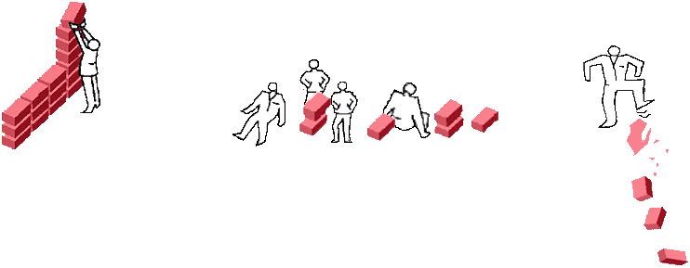


THE EMPLOYEE CLASSIFICATION ACCORDING TO GALLUP
Employee engagement is the emotional commitment the employee has to the organization and its goals.
Engaged
Not Engaged
Actively Disengaged
These employees are loyal and psychologically committed to the organization. They are more productive and more likely to stay with their company for at least a year.
These employees may be productive, but they are not psychologically connected to their company. They are more likely to miss workdays and more likely to leave.
These employees are physically present but psychologically absent. They are unhappy with their work situation and insist on sharing this unhappiness with their colleagues.

Slide 19
Gallup
The Gallup organisation has been measuring employee engagement since 2000, and their recent studies found results consistent with Towers Perrin.
Gallup estimates the annual economic costs associated with disengagement as high as £32 billion in the UK. 100 billion Euros in France, and $370 billion in the United States.

Slide 20
 | engaged | not engaged | actively disengaged
Norway | 17 | 75 | 8
Iceland | 16 | 76 | 8
Germany | 15 | 70 | 15
Sweden | 14 | 75 | 11
Switzerland | 13 | 76 | 12
Austria | 12 | 71 | 18
United Kingdom | 11 | 68 | 21
France | 6 | 69 | 25
Spain | 6 | 79 | 15
Italy | 5 | 64 | 30

Slide 21

The change goal must be defined concretely in behavioral terms not as «cultural change» EH Schein, 2017
Remember:
Behavior change leads to culture change only if the new behavior is perceived to make things better
Define desired values and behaviors. Do people
understand them and how they relate to
day-to-day behavior?
Come up with behavioral descriptors for each value you define and articulate how those would translate into actionable behaviors at all levels.
When contemplating a culture change, look at your current culture and call out which aspects you want to retain. Define the non-negotiables. Determine what is particularly important to change and what’s not up for debate.
Notes:
Avoid negative comments of failures
Quick wins and reinforcement of successive approximations to the final goal
Training if necessary without being coercive Redefine old concepts giving new meanings Include «unlearning» in the transformation process

Slide 22

Positive & negative emotions at work
The functionality of negative emotions:
Negative emotions motivate and prepare us to escape the danger, we focus on detail, on what is wrong with a situation.
The functionality of positive emotions:
Experiencing positive emotions we tend to broaden our scope of attention, look more at the big picture rather than the details of a circumstance .
Positive affect gives rise to enlarged cognitive context, thinking out of the box, more flexible cognitive categories, and we are better able to process info in an integrated but flexible manner.
We create more stable and supportive relationships.

Slide 23
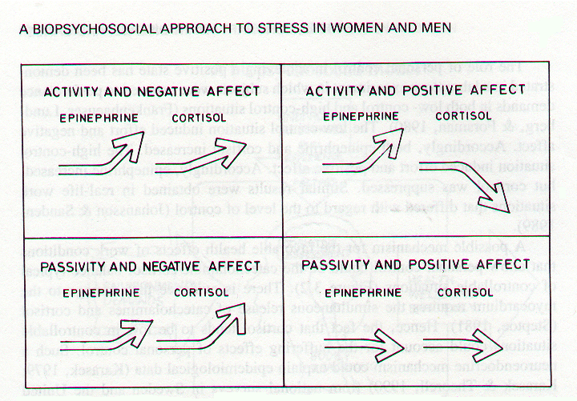

Slide 24
Creating a strengths-based workplace brings out the best in employees —regardless of an organization’s industry or geography- it improves organizational success.
BUSINESS UNITS ACHIEVED PERFORMANCE INCREASES OF UP TO:
BUSINESS UNITS SHOWED DECREASES OF UP TO:
7% IN CUSTOMER ENGAGEMENT
15% IN EMPLOYEE ENGAGEMENT
29% IN PROFIT
59% IN SAFETY INCIDENTS
41% quality issues
16 POINTS IN TURNOVER (LOW-TURNOVER ORGANIZATIONS)
72 POINTS IN TURNOVER (HIGH-TURNOVER ORGANIZATIONS)
GALLUP'S 2015 STRENGTHS META-ANALYSIS INCLUDES:
49,000 BUSINESS/WORK UNITS, 2 million EMPLOYEES, 45 COUNTRIES

Slide 25
Positive comments
The single most important factor in predicting organizational performance is the ratio of positive statements ( appreciation, support, helpfulness, approval, compliments) to negative statements.
A ratio of between 3 and approximately 8 positive statements to every 1 negative statement is predictive of the highest level of performance.
Negative communications were present in high-performing organizations but just not to the extent that they dominated or even matched the positive .
Organizations that performed moderately well had about an equal number of positive and negative comments, and organizations that performed poorly were more negative than positive (Losada & Heaphy, 2004)
Notes:
Gottman index: 5 to1 ratio in successful marriages pag 69

Slide 26
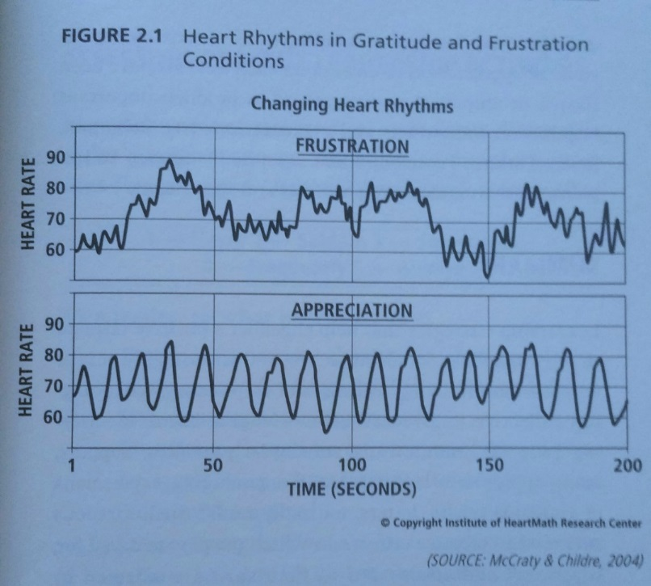
Gratitude has been found to have dramatic effects on individual and group performance

Slide 27
Primary Embedding Mechanism:
The Creation of the Organizational Culture E. Schein
What we pay attention to, measure, and control on a regular basis
How we react to critical incidents and organizational crisis
Deliberate role modeling, teaching, and coaching
How rewards and status is allocated
How the organization recruits, selects, promotes, and excomminicates

Slide 28
Secondary Mechanism
Organizational systems and procedures
Rites and rituals of the organization
Design of physical space, façades, and buildings
Formal statements of organizational philosophy, creeds, and chartres
Stories about important events and people

Slide 29
Change happens, if A+B+C>D
A: dissatisfaction with the present situation
B: clear and attractive vision of future
C: first steps
D: costs (economical, psychological, political)

Slide 30
Models of personal change

Slide 31
Forbes
Given enough time and money your
competitors can duplicate almost
everything you’ve got working for you...
….except your culture.

