Slide 1
Artificial Intelligence & quantum technologies
Risks and ethical opportunities
IORDANIS KERENIDIS
Research Director CNRS
Head of QC WARE France

Slide 2
Artificial intelligence in healthcare
The use of complex algorithms and large sets of medical data in order to help performing a variety of medical tasks, e.g.
Medical Imaging analysis
Diagnostics
Treatment protocols
AI Medical Assistance
Drug discovery/development
Robot-assisted surgery

Slide 3
Artificial intelligence in healthcare
The use of complex algorithms and large sets of medical data in order to help performing a variety of medical tasks, e.g.
Medical Imaging analysis
Diagnostics
Treatment protocols
AI Medical Assistance
Drug discovery/development
Robot-assisted surgery

Slide 4
Artificial intelligence in healthcare
The use of complex algorithms and large sets of medical data in order to help performing a variety of medical tasks, e.g.
Medical Imaging analysis
Diagnostics
Treatment protocols
AI Medical Assistance
Drug discovery/development
Robot-assisted surgery

Slide 5
Artificial intelligence: HOW does it work?

Slide 6
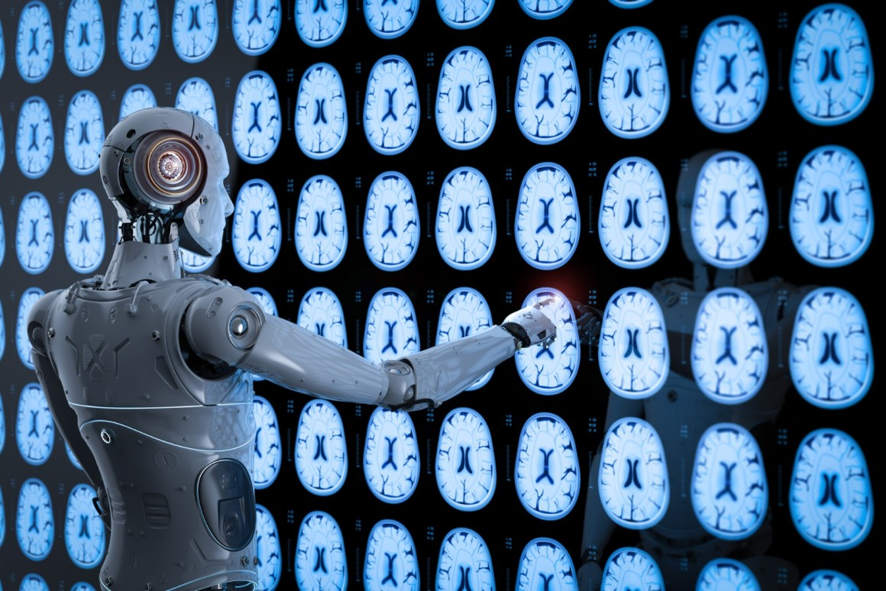
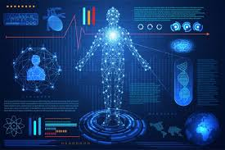
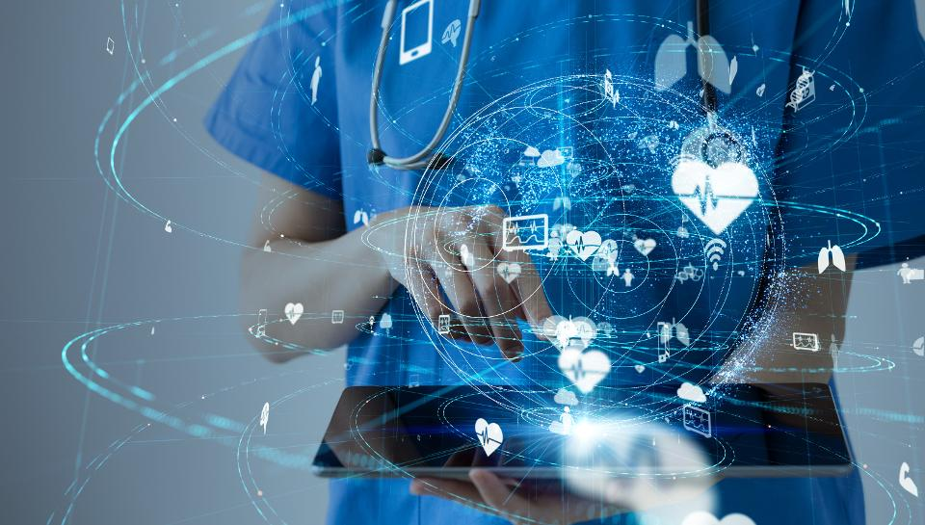
Artificial intelligence: HOW does it work?

Slide 7
Artificial intelligence: HOW does it work?
REALLY

Slide 8
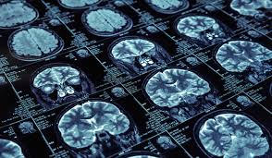
Artificial intelligence: HOW does it work?
REALLY
LABELLED DATA
Examples
Brain images labelled normal/tumour/stroke/hemmoraghea
Patient’s files with symptoms, tests, diagnosis
Patient’s files with treatment protocols and success rates
Clinical trials

Slide 9
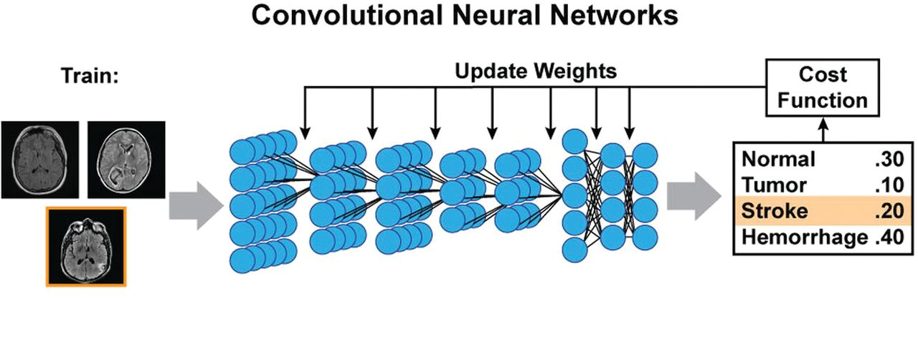
Artificial intelligence: HOW does it work?
REALLY
TRAINING
Artificial Neural Network: Neurons, connections
Initial Layer : image / Final layer: labels
Neuron : {activated, deactivated}
Initially: white pixel black pixel

Slide 10
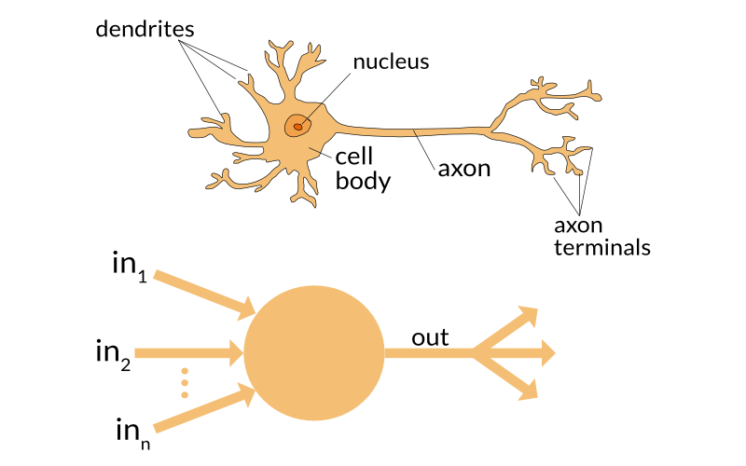
Artificial intelligence: HOW does it work?
REALLY
TRAINING
Artificial Neural Network: Neurons, connections
Initial Layer : image / Final layer: labels
Neuron : {activated, deactivated}
Initially: white pixel black pixel
Neuron takes input signals and produces output signal according to some activation rule
Example Activation rule: “output the majority of the inputs”

Slide 11
Artificial intelligence: HOW does it work?
REALLY
TRAINING
Training goal:
Find rules such that for the “tumor” images,
in the final layer only the neuron labelled
“Tumor” is activated, and so forth.

Slide 12
Artificial intelligence: HOW does it work?
REALLY
TRAINING
Training goal:
Find rules such that for the “tumor” images,
in the final layer only the neuron labelled
“Tumor” is activated, and so forth.
Training method:
Start with some rules
Check if results are OK (rewards/penalties)
If not, update the rules
Try until results are satisfactory

Slide 13
Artificial intelligence: HOW does it work?
REALLY
LABELLED DATA TRAINING

Slide 14
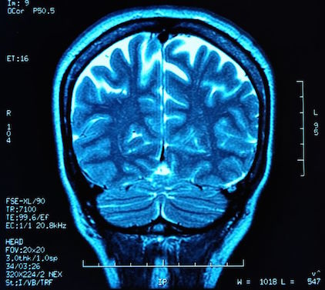
Artificial intelligence: HOW does it work?
REALLY
LABELLED DATA TRAINING DIAGNOSIS

Slide 15
Artificial intelligence: how does it work?
SUPERVISED LEARNING (learning from labelled data)
Medical Imaging Analysis [data: labelled images]
Diagnostics [data: patient’s file, symptoms, test results, diagnosis]
Treatment protocols [data: patients’ files, treatment protocols, success rate]
AI Medical Assistance [data: Natural Language Processing]

Slide 16
Artificial intelligence: BIASES

Slide 17
Artificial intelligence: BIASES
LABELLED DATA

Slide 18
Artificial intelligence: BIASES
LABELLED DATA
doctors

Slide 19
Artificial intelligence: BIASES
LABELLED DATA
nurses

Slide 20
Artificial intelligence: BIASES
LABELLED DATA
Unfortunately, the medical datasets openly available for use by AI researchers are notoriously biased, especially in the US. It’s not a secret: Health-care data is extremely male and extremely white, and that has real-world impacts. A 2014 study that tracked cancer mortality over 20 years pointed to a lack of diverse research subjects as a key reason why black Americans are significantly more likely to die from cancer than white Americans.
Lack of reduction in racial disparities in cancer‐specific mortality over a 20‐year period,
A. Aizer et al.

Slide 21
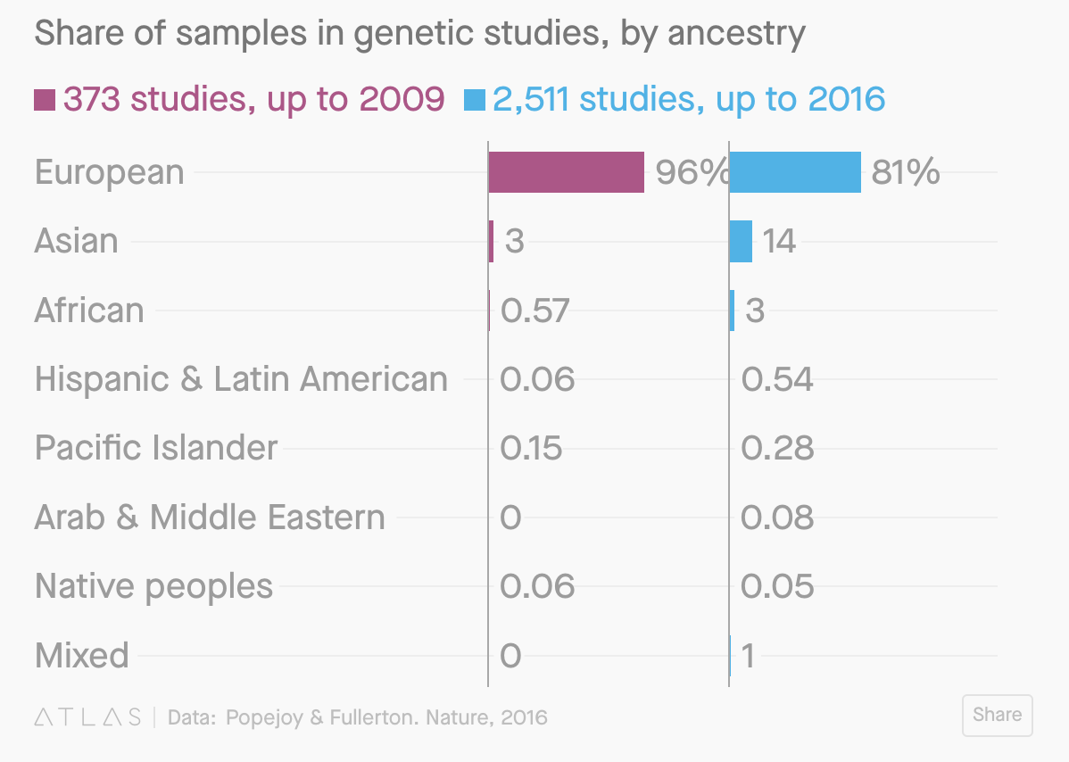
Artificial intelligence: BIASES
LABELLED DATA
Unfortunately, the medical datasets openly available for use by AI researchers are notoriously biased, especially in the US. It’s not a secret: Health-care data is extremely male and extremely white, and that has real-world impacts. A 2014 study that tracked cancer mortality over 20 years pointed to a lack of diverse research subjects as a key reason why black Americans are significantly more likely to die from cancer than white Americans.
Lack of reduction in racial disparities in cancer‐specific mortality over a 20‐year period,
A. Aizer et al.

Slide 22
Artificial intelligence: BIASES
LABELLED DATA
We need good data
If data is biased, incomplete, not diverse, then the training will reflect this bias

Slide 23
Artificial intelligence: BIASES
TRAINING (update rules through rewards/penalties)

Slide 24
Artificial intelligence: BIASES
TRAINING (update rules through rewards/penalties)
What is the penalty when a tumor is labelled normal?
- High penalty implies good diagnosis but more false positives
- Small penalty implies worse diagnosis but less expenses

Slide 25
Artificial intelligence: BIASES
TRAINING (update rules through rewards/penalties)
What is the penalty when a tumor is labelled normal?
- High penalty implies good diagnosis but more false positives
- Small penalty implies worse diagnosis but less expenses
How do we define success of the algorithm?
Example: Success if AI is correct on 80% of patients
- 80% on each category of patients
- 100% on Category A, 60% on Category B

Slide 26
Artificial intelligence: BIASES
LABELLED DATA TRAINING
We need good data
If data is biased, incomplete, not diverse, then the training will reflect this bias
We need AI and Health experts to work together
Rewards and penalties during training affect the final model

Slide 27
INTERPRETABILITY of the model
Different models have different levels of interpretability
Interpretable models: Features selection, Linear regression, Decision trees
Not-so-interpretable models: Neural networks, deep learning [but more accurate]

Slide 28
INTERPRETABILITY of the model
Different models have different levels of interpretability
Interpretable models: Features selection, Linear regression, Decision trees
Not-so-interpretable models: Neural networks, deep learning [but more accurate]
Interpretability is important for a number of reasons
Identify and undo biases
Model improvements through better data collection
User trust: ‘There are more Americans who think that high-level machine intelligence will be harmful than those who think it will be beneficial to humanity.’ Center for Governance of AI

Slide 29
Artificial intelligence: BIASES
LABELLED DATA TRAINING INTERPRETABILITY
We need good data
If data is biased, incomplete, not diverse, then the training will reflect this bias
We need AI and Health experts to work together
Rewards and penalties during training affect the final model
Interpretable models allow for identifying biases, collecting better data, and becoming trustworthy

Slide 30
Artificial intelligence: BIASES
LABELLED DATA TRAINING INTERPRETABILITY
ACCOUNTABILITY
We need good data
If data is biased, incomplete, not diverse, then the training will reflect this bias
We need AI and Health experts to work together
Rewards and penalties during training affect the final model
Interpretable models allow for identifying biases, collecting better data, and becoming trustworthy
Who could be accountable?
Data collection and preparation (clinical trials, patient data bases, labeling, etc.)
Training methods (AI experts, Healthcare experts, defining rewards and penalties)
Rules for necessity of interpretability of models

Slide 31
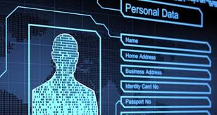
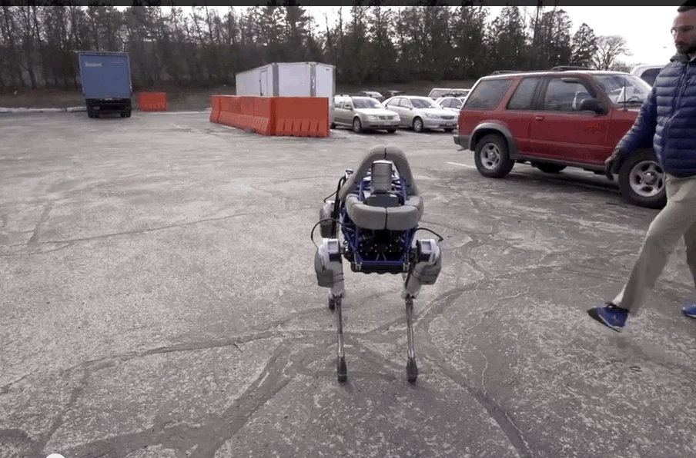
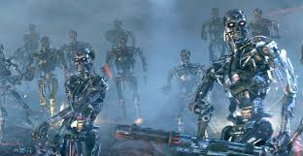
Other issues
DATA PRIVACY ETHICS OF ROBOTS THE SINGULARITY

Slide 32
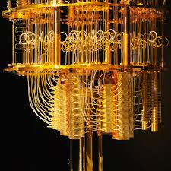
QUANTUM TECHNOLOGIES
Quantum computer use properties of quantum systems to solve specific problems much faster
Optimization
Machine Learning
Quantum Chemistry

Slide 33
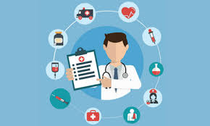
QUANTUM TECHNOLOGIES in healthcare
Molecule simulation / Drug Development / Ligand design
Machine Learning and Optimization

Slide 34
THANK YOU

