Slide 1
How has the crisis accelerated the use of ARTIFICIAL INTELLIGENCE toward eHealth?
Anne-Sophie BRICCA

Slide 2
Artificial Intelligence in Healthcare
The use of complex algorithms and large sets of medical data in order to help perform a variety of medical tasks, e.g.
Medical Imaging analysis
Diagnostics
Treatment protocols
AI Medical Assistance
Drug discovery/development
Robot-assisted surgery

Slide 3
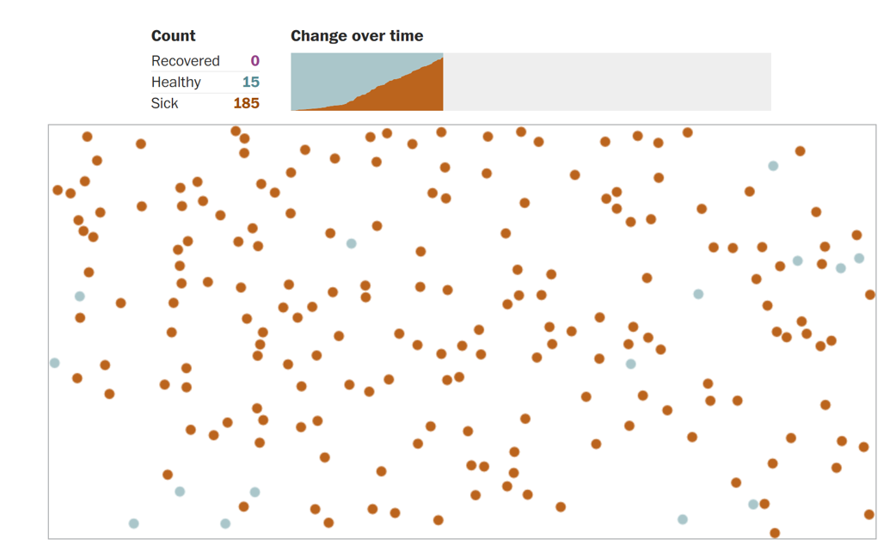
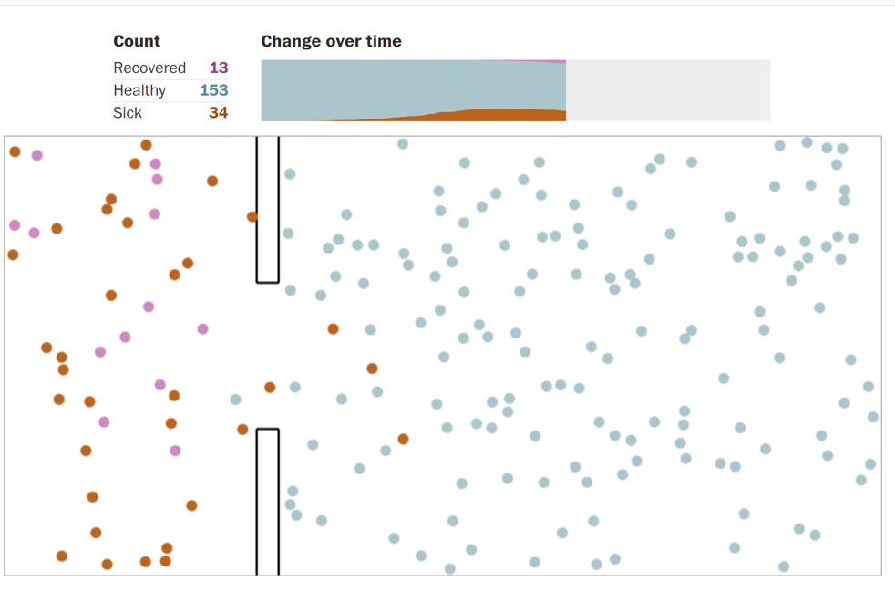
Free movements
Seal off the sick population from the healthy
Moderated Distancing (one over four)
Extensive Distancing (one over eight)
AI for Pandemia Simulation

Slide 4
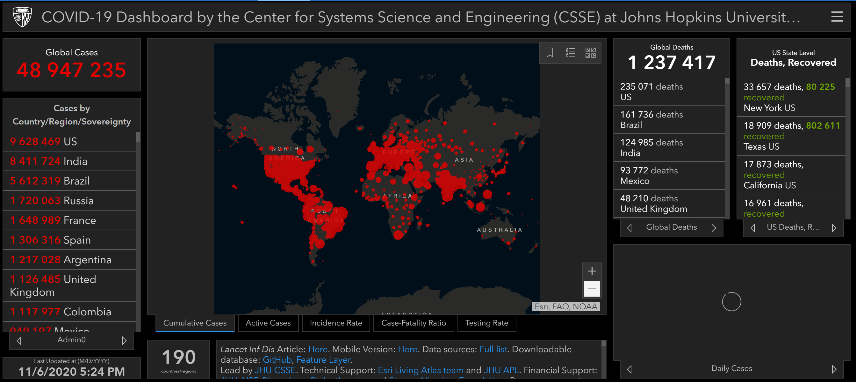
AI Driven Infectious surveillance

Slide 5
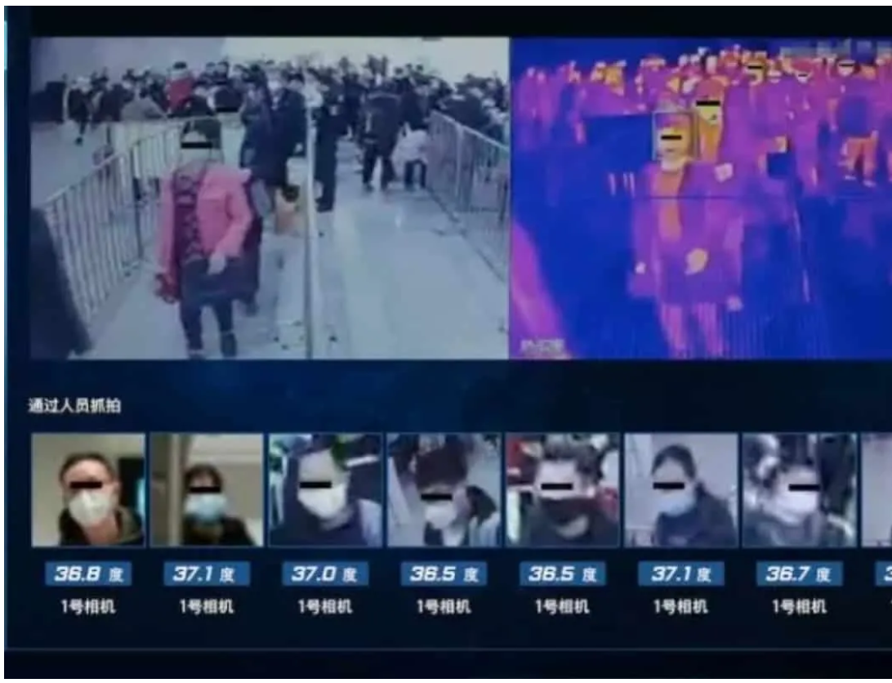
AI to detect fiver
In Beijing, a system developed by Baidu (the Chinese Google) scans passengers at Qinghe station using a combination of infrared and facial recognition.
If a person's temperature exceeds 37.3 degrees, an alarm is triggered and the station staff perform a second test.
According to Baidu, the system can check more than 200 people per minute. This is much faster than the thermal scanners used at airports.

Slide 6
Corona-Warn-App in Germany, COVID tracker" in Ireland, Immuni in Italy, TousAntiCovid in France, NHS Covid-19 in UK,…
Downloaded by approximately 30 million people
Connected systems within EU
AI for Tracer App.

Slide 7
AI for Diagnosis
Chinese tech and e-commerce giant Alibaba, has developed an artificial intelligence algorithm capable of diagnosing coronavirus with 96% accuracy
This AI can distinguish patients infected with CoV-2-SARS from those with ordinary viral pneumonia.
It could help reduce the pressure on hospitals, as it allows diagnosis to be made in as little as 20 seconds

Slide 8
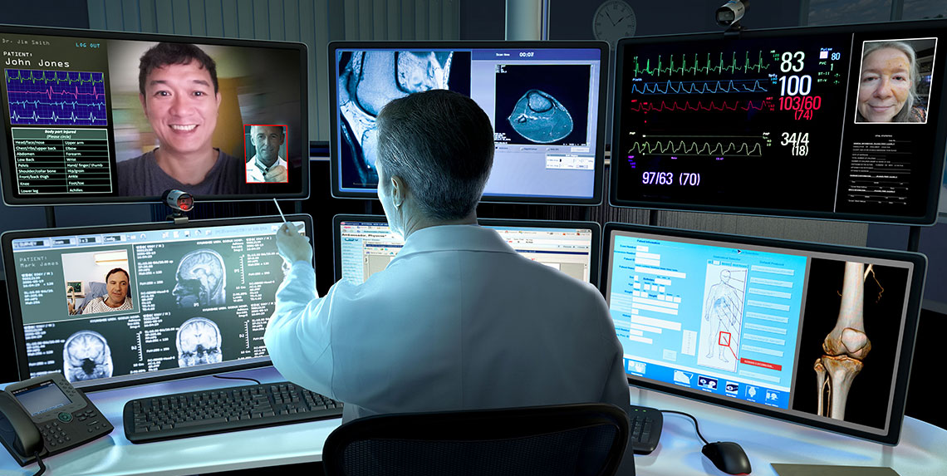
Use of Telemedicine
To screen patients remotely (triage)
To help provide routine care for patients with chronic diseases
To limit HCP continuous exposure to infected patients

Slide 9
AI for new treatments
Machine learning and other technologies are expected to make the hunt for new pharmaceuticals quicker, cheaper and more effective.
Use of AI to develop a worldwide database of all molecular compounds.

Slide 10
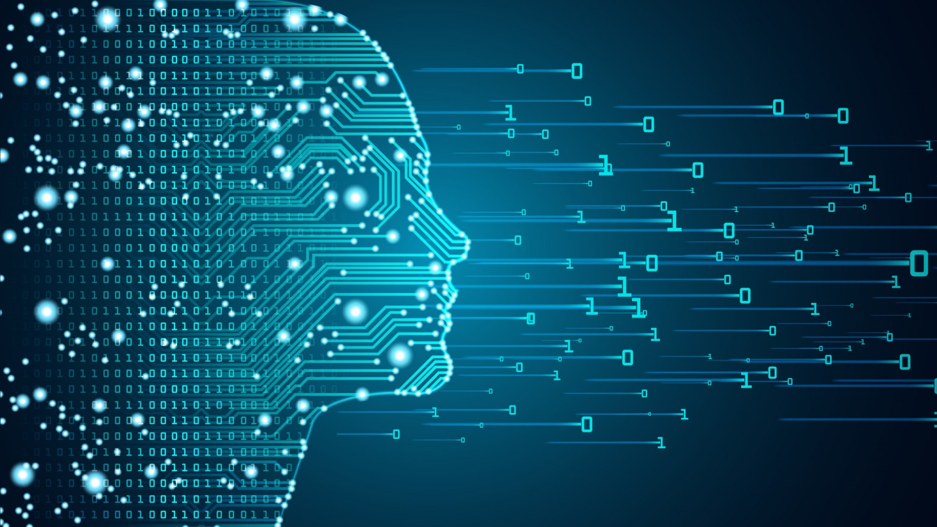
DATA
BIAS
TRANSPARENCY
LIABILITY

Slide 11
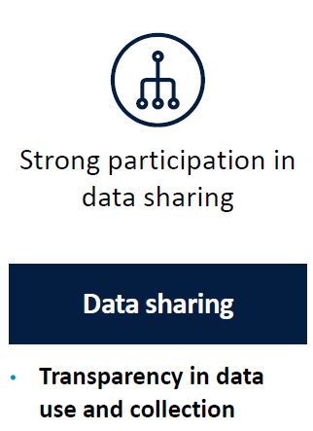
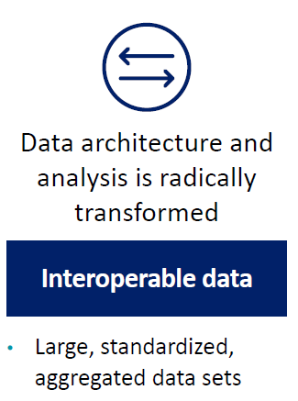
DATA

Slide 12
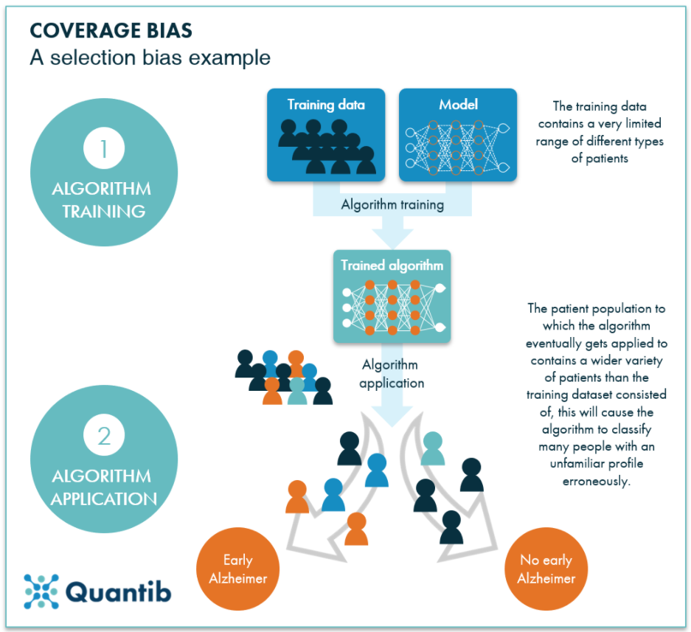
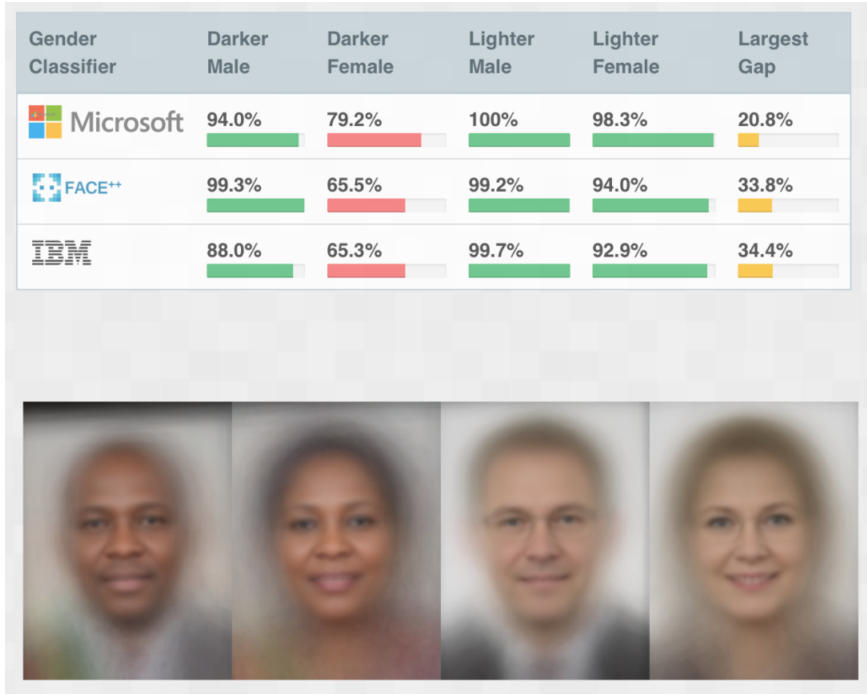
BIAS

Slide 13
AI Products
Conventional Product
Diagnosis
Mechanical stage
Intelligent stage
Treatment
Physiscs
Biology
Chemistry
Analysis of data
Algorithm
Generalization ability

Slide 14
AI Products which provide information to HCP to make decision.
AI Products which perform a medical task on patient.
Potential Harm
Problem Definition
Immaterial harm: loss of privacy, limitation of freedom, human dignity, discrimination,…
Material harm: safety and health of individuals , including loss of life, bodily injury,…
WARNING

Slide 15
Conclusion
Values definition: why are you adopting AI tools? To which purpose? Who will be the beneficiaries?
Risk assessment matrix
Training and education: awareness as a means of encouraging an ethical mindset
Appointment of an Ethics Officer

