Slide 1
Healthcare Industry Responses to the Pandemic: An Opportunity to Rebuild Trust?
N. Craig Smith
INSEAD Chaired Professor of Ethics & Social Responsibility
ETHICS General Assembly, November 2020

Slide 2
Poll Question
In terms of public perceptions and overall reputation, will the healthcare industry come out of the Covid-19 pandemic looking better, worse, or no different?
Better
Worse
No different

Slide 3
Healthcare Industry & COVID-19
Impacts of COVID-19
> 1 million deaths worldwide
“if this goes on for a long time, it’s certainly going to be the mother of all financial crises” (economist Kenneth Rogoff)
Lives or livelihoods?
Healthcare industry as potential saviour?

Slide 4
Healthcare Industry & COVID-19
Great Challenge:
To develop the vaccines and treatments with unprecedented speed
To change/adapt the industry business model
Great Opportunity:
Healthcare has the scientific know-how, the management capabilities, and physical/technological capacity to develop treatments and vaccines
Restore the trust deficit

Slide 5
The Trust Deficit (Edelman 2017)
… trust in healthcare and most of its verticals remains low relative to other industries globally… pharma, consumer health and insurance providers on average remain in “neutral” versus “trusted” territory…
Pharma in particular continues to face headwinds, with the Trust Barometer showing that 8-in-10 people (globally) believe:
the government needs to do more to regulate the pharmaceutical industry
the pharmaceutical industry puts profits over people
Source: https://www.edelman.com/post/trust-healthcare-making-progress

Slide 6
Trust in Healthcare (Edelman 2019)

Slide 7
Trust in Healthcare (Edelman 2019)

Slide 8
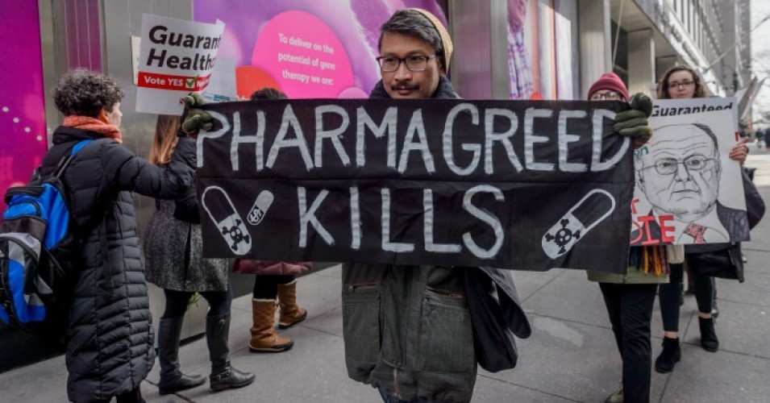
Healthcare Industry Reputation
The trust deficit
Healthcare is different
Reputation tarnished by illegal marketing practices, corruption scandals, obscene pricing on vital drugs
Tomorrow?
What is the point of an industry that is one of the most profitable if it falls short when we need it most?
Successful collaboration with other players in race to develop treatments
Healthcare seen as truly putting patients’ needs first

Slide 9
Industry Business Model
Context
Questioning idea of purpose of business as maximizing shareholder value
Organizations should have priorities beyond increasing financial returns
Healthcare industry response
Guided in principle by patient centricity
Double down on developing products that help protect public health and find cures to diseases—with success
BUT hugely expensive, insufficient focus on big-killer diseases, escalating prices of medications
Industry reliance on competition-based model

Slide 10
Fighting the Pandemic Collectively
Competition-based model—a liability in race to develop drugs and vaccines to combat COVID-19?
Hit the pause button (temporarily?) on industry’s traditional ways of doing business and find new ways to work together
Success in fighting the pandemic requires companies accustomed to working largely on their own to pool resources with competitors and work more closely with state organizations and bodies like the WHO
Specifically:
Share research to develop treatments for the virus
Team up to manufacture new drugs
Forgo normal approaches to pricing and drug allocation

Slide 11
Healthcare Industry Response to COVID-19?
“Only by taking extraordinary actions can pharma truly live up to its higher purpose of developing products that help to protect health and cure diseases. There is some evidence that important shifts are underway. But even when the need for change is clear and urgent, it’s not easy to teach old dogs new tricks.”

