Slide 1
UNHCR: A values-based approach to ethics and integrity
- in times of uncertainty
Presentation: 2020 ETHICS General Assembly
12 November 2020 (virtual)
Helmut Buss, Director, Ethics Office

Slide 2
Presentation Outline
UNHCR Context
II. Values-based approach
Framing the new approach
Examples of steps taken
III. Reflections from the COVID crises

Slide 3
UNHCR Operational Context
82.5 M
People of concern to UNHCR worldwide
$ 9.131 bn / 4.279 bn
approx. 87% contributed by governments and EU and 10% from private donors
1000 +
UNHCR partners globally

Slide 4
Challenges for Ethics
Increase in short-term staffing
Emergency context overrides focus on ethics/values
Working in remote or high-risk duty station
Mandatory rotation
Direct contact to people of concern
Inadequate induction on ethics
Context pressures and ethics risks !

Slide 5
New approach – some shifts
Compliance/misconduct
Behaviour/values – ethical reflections and decisions
Oversight/complaints
Managers with support/ responsibility
Entity focus – ‘who is doing what’
Client focus –
‘what are we trying to achieve for whom’
Confidentiality/
separation
Confidentiality/
collaboration, trust, accountability
One size fits all HR/ ePAD
People Management/
Support tools (coaching)

Slide 6
New approach -
Behaviour
- It is about….
We ask….
Is there alignment? – is what we want, what we support?
What is the behaviour we desire?
What influences behaviour?

Slide 7
Understanding what influences behaviour
Capacity, trust and reputation of the organization
Impact
Personal capacity decisions/actions
Organizational capacity decisions/actions
Decision & action
Behaviour/actions can be: Legal/illegal; within/outside rules; ethical/unethical
Personal / Internalized
Rules framework
Org. systems
Areas
Laws
Environment & context
Personal values & culture
CoCD
Rules and regulation
Code of Conduct
Factors
Org. values & culture
Experiences & maturity
Risk appetite
Decision making processes
Decision-Maker
Emotions
Fears/Desires

Slide 8
New elements in our approach - some concrete steps
Behaviour focused activities:
Values in Action – linking personal to organizational values through CoC dialogue
‘Responsibilising’ Colleagues – encourage self-reflection
Experiential Learning –value-spotting
Science- based communication – story telling
Embedded in leadership – people management
& dialogue

Slide 9
Values in Action – Code of Conduct Dialogue
Yearly Code of Conduct refresher sessions – with local facilitators
Mandatory Code of Conduct Dialogue sessions – with local facilitators
Focus on the does and don’t in the Code of Conduct
Focus on experiential learning and reflection about behaviour – key messages
Main tool – Code of Conduct
New tools – visuals, facilitator guide, exercises
NEXT STEPS
Increased leadership, part of risk, linking personal and organizational ethics

Slide 10
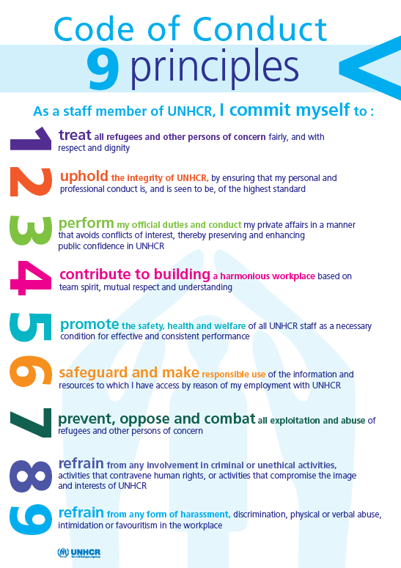
Code of Conduct – Values in Action
Rules:
UN Charter
UN Staff Rules and Regulations
UNHCR Code of Conduct
UN Oath of Office
UNHCR Policies and Procedures
Core UN values:
Integrity
Professionalism
Respect for Diversity

Slide 11
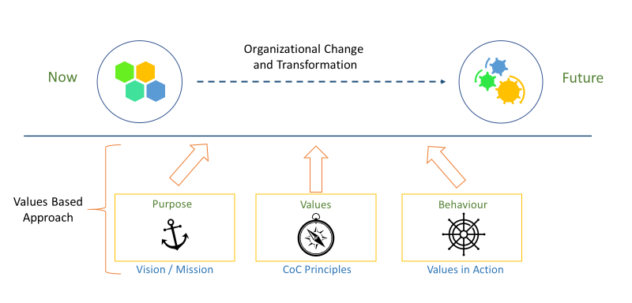
Introducing values
Notes:
reflects the values and how these are about our behaviour – values in action.

Slide 12
Introducing key messages
You are invited to………..
Turn judgement into curiosity
Turn disagreement into shared exploration
Turn defensiveness into self reflection
Turn assumptions into questions
Include everyone’s voices
STOP – PAUSE – REFLECT - ACT

Slide 13
Inviting self-reflection and awareness
Key messages
Value-spotting
Your actions matter!
We are all involved
Stop-pause-reflect
Values drive our ethical behaviour and decision making
The dialogue is an on-going process not a one time learning

Slide 14
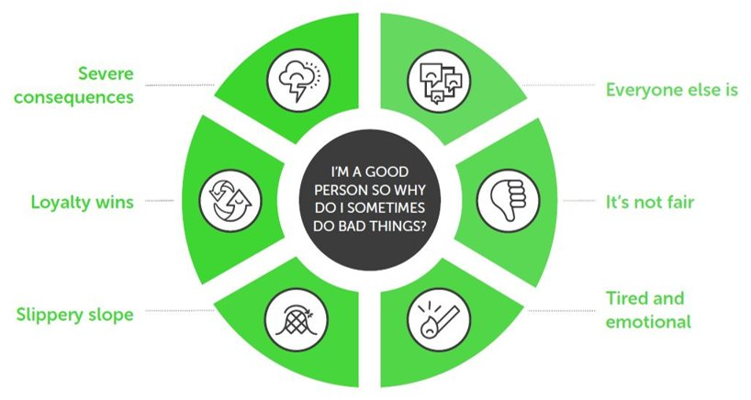
Inviting self-reflection and awareness
Why do good people do bad things?
Source: Jonathan Haidt & Azish Filabi (2017): “The only way is ethics”​

Slide 15
Dialogue and ethical dilemmas – new approach
Facts & Issues
Rules & Guidelines
Questioning actions
Image of UNHCR
In the News
External Help
Ethics advise:
Weigh different aspects of the case
Go through the steps to assess pros and cons
Identify mitigating measures if required

Slide 16
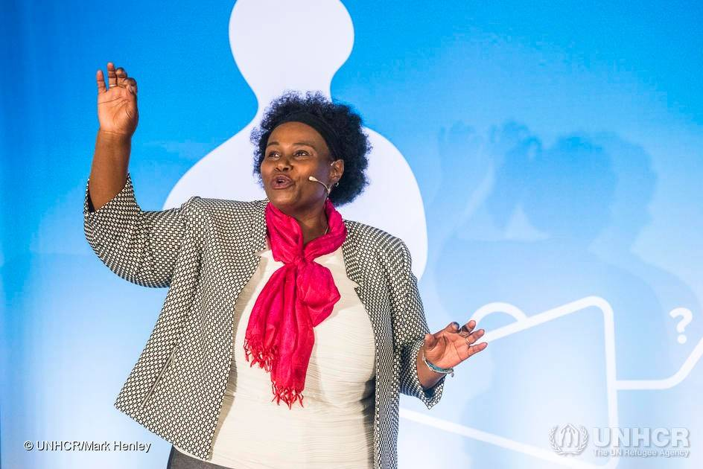
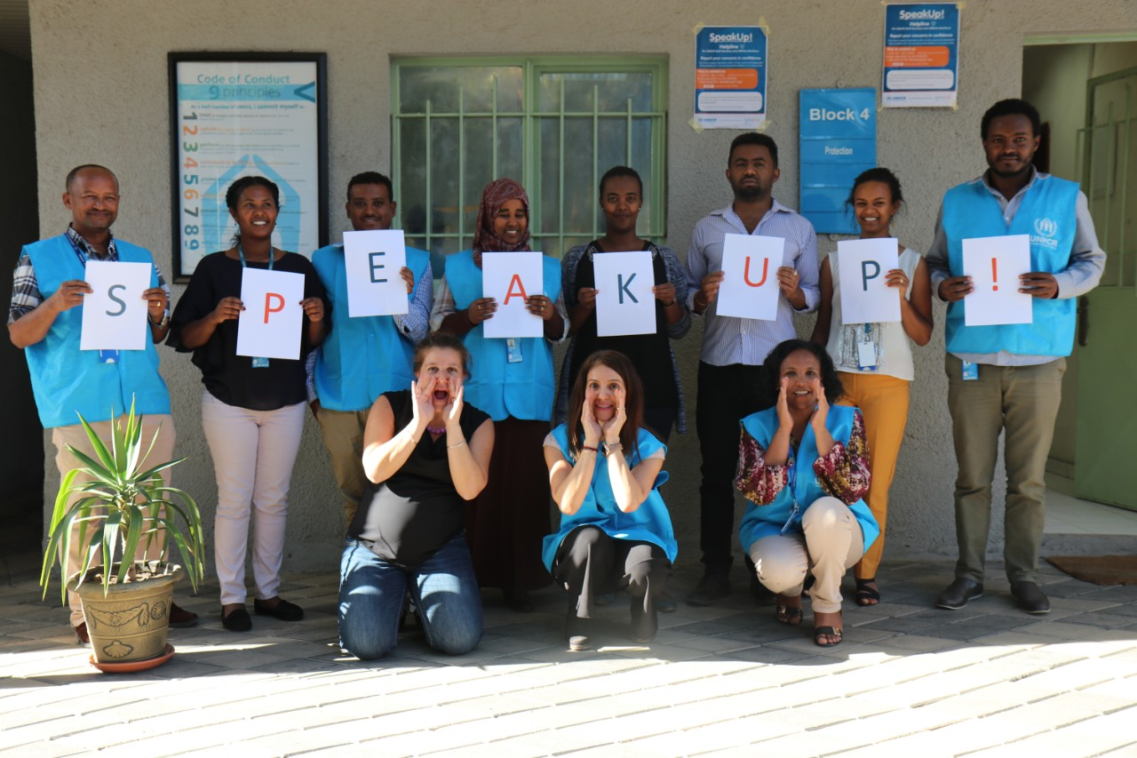
Story-telling, outreach and visuals
Innovative illustrations: posters, postcards
Story-telling
Virtual facilitation: Mentimeter, SurveyMonkey, Meeting Magic
Speak Up helpline

Slide 17
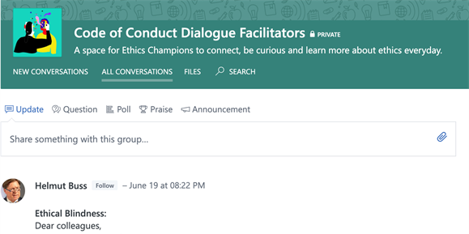
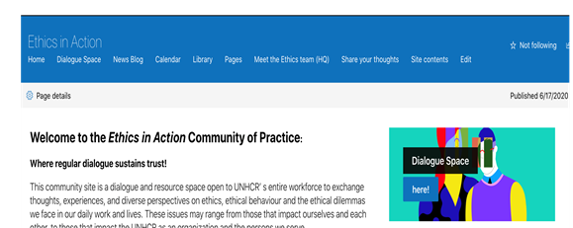
Spaces for dialogue
Code of Conduct: ongoing activities
Learning and development
- Reflective leadership dialogue
Ethics in Action Platform
Global Networks of Ethics Influencers: - Yammer groups & grassroots
Future of Ethics
COVID-19
Equality for all

Slide 18
Leadership and Culture
Vision and values
Tone at the top
Build trust – what you say is what you do
Co-create & empower
Communicate the culture & change we want to see
Provide spaces for dialogue
Code of Conduct – as dialogue sessions

Slide 20
Summary and reflections from the COVID crises
Leadership, values, and prioritization
Trust, collaboration, dialogue, and problem solving
Working across Silos
Ethical decision making/ Ethical Blindness
Themes arising from COVID crises:
“Stay and Deliver/ Duty of Care”
“Technology opportunities and risks”
“Loss of direct contact with persons of concern”
“Mobility – role of local staff, new climate friendly ways(?)”

Slide 21
Q&A
Thank you!

