Slide 1
Education Best Practices Sharing
Ingrid Callies, Cécile Gousset, Piergiorgio Pepe,
with the support from Sue Egan

Slide 2
Agenda
Purpose
Which format
Examples
Technical aspects, architecture
How to engage together

Slide 3
Purpose
Rather than reinvent the wheel, to share best practices on topics linked in particular to education and training:
With no issue of intellectual property or confidentiality,
With no commercially sensitive information from a competition law perspective,
That we know works well,
And that can be customized by each member.
To foster a compliance mindset, it is critical to deliver training in different ways and through different channels
Training & education = One pillar of a compliance program

Slide 4
Which format
Can be very variable
Material ready to share
Examples:
Case study
Power point presentation
Brochure
Video…
Link to other websites to access material and « ideas »
Examples:
National associations Websites -> access to their e-learning
Law firm Website which has developed an educational film about ethics & compliance

Slide 5
Examples of material ready to share

Slide 6
Case study

Slide 7
Case study

Slide 8
Power point presentation

Slide 9
Power point presentation

Slide 10
Brochure
Brochure to be distributed to external experts to share the company standards and values, and support daily activity of the company employees

Slide 11
Video
Example of a video accessible through You Tube about insider dealing
http://www.youtube.com/watch?v=lzFX-qGQdKs&list=PLO7SodxCJyn56Zo27JwZFKDhwauzeBSKs

Slide 12
Examples of links to other websites

Slide 13
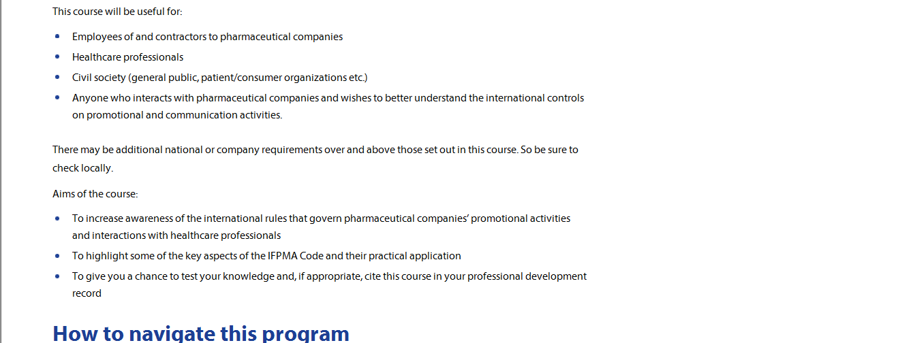
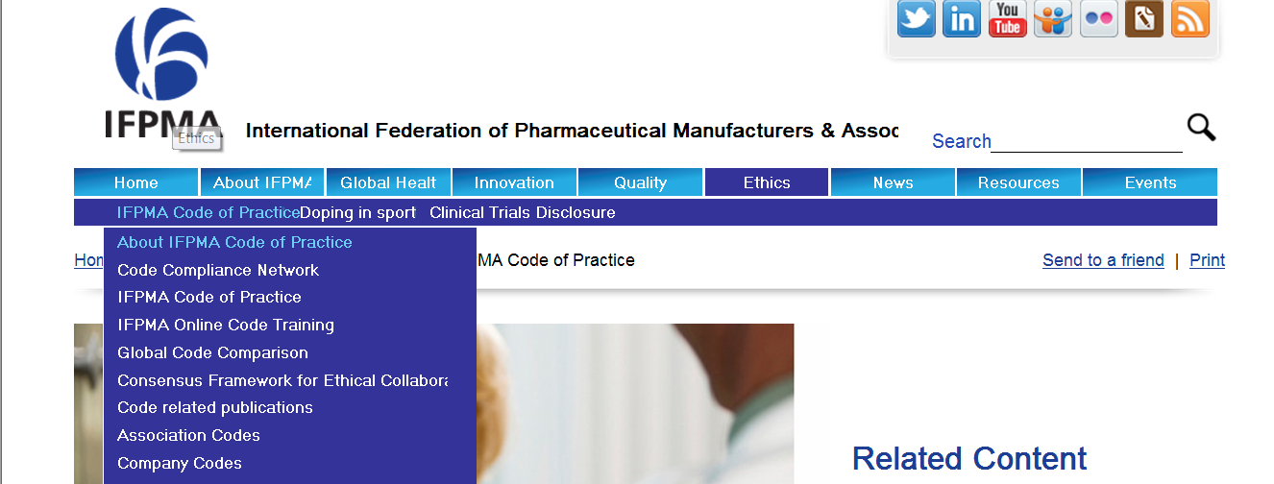
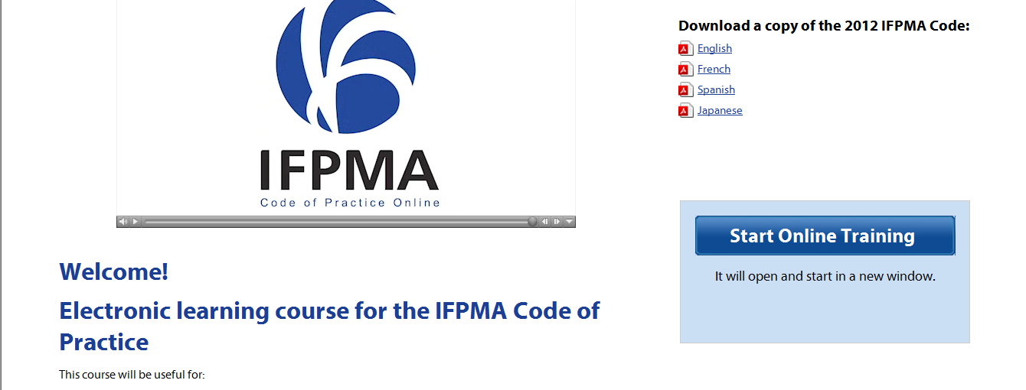
IFPMA Website
http://www.ifpma.org/

Slide 14
Technical aspects, architecture
Simple architecture in the member space:
Education Best Practice Sharing
When we will have enough material, it could be filed in different sub-categories
A short news will explain the purpose /objective of each material posted
Search can be facilitated using Key Words in each material

Slide 15
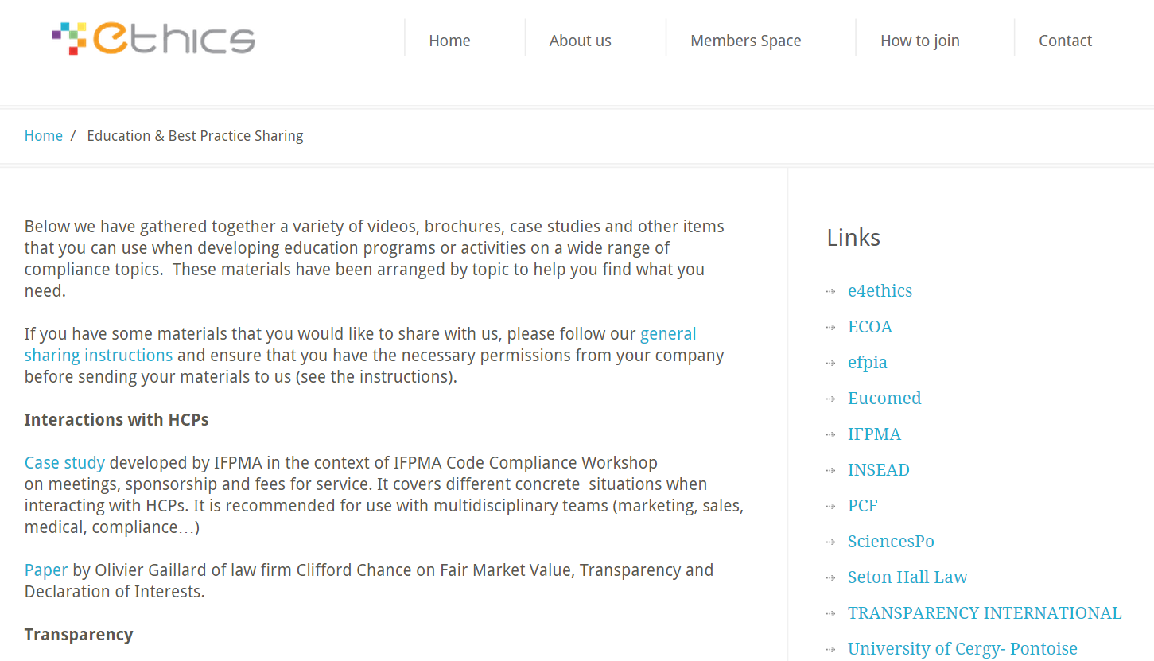

Slide 16
Submission ground rules
Short content summary, including key words for the search functionality, for each submission
Disclaimer to include in any material submission:
“The materials submitted do not contain any information which is commercially sensitive, sensitive from a competitive perspective, IP-protected, confidential or proprietary to this company. They are suitable for sharing among the members of Ethics and have been cleared for this purpose in line with the applicable company/organization policy”.

Slide 17
Process for submitting, reviewing and posting material
Submission to … (central contact address); including content summary
Content review by … till … (e.g. Strategic Committee or team members with the support of Sue, 4 weeks after entry date)
Feedback to submitter [accepted or rejected (with reasons)]
The team members up-load the selected material on the ETHICS website
Submitter gets e-mail notification about up-load
New document gets a NEW flash for … days
After … months submitter gets e-mail notification to delete/revise/continue material as relevant
→ Guidance to be provided

Slide 18
Best practices sharing
Without the contributions from Ethics members, this cannot happen.
So let’s discuss at the break with volunteers!

