Slide 1
ELEVATING COMPANY CULTURE
Piergiorgio Pepe, ETHICS member, Quantum Ethics, Sciences Po
ETHICS General Assembly 2019
DAY 1 – Wednesday 20th November 2019

Slide 2
ELEVATING COMPANY CULTURE
Introduction of the Fresenius case: Piergiorgio Pepe, ETHICS member, Quantum Ethics, Sciences Po
Guiding cultural change in Compliance & Ethics: Beatrice Bauer, Associate Professor of Practice of Leadership, Organization & Human Resources, SDA Bocconi School of Management
Culture - alternative training models: Nadège Rochel, Global Compliance Manager, Hollister
Q&A Session
Bad culture, a breeding ground for corrupt schemes: Guido Palazzo, Professor of Business Ethics, Lausanne University (tomorrow at 9am)

Slide 3
Fresenius 2019 FCPA Case

Slide 4
Why the Fresenius Case?
Recent case
Providing clear indication of the key role of company culture in compliance issues
Helping reflect upon some of the key challenges that Ethics and Compliance officers may face
Helpful introduction to today’s session on ELEVATING COMPANY CULTURE

Slide 5
Fresenius case 2019: Outline
Case Outline
The Basic Breaches
Some Concrete Examples of Problematic Culture
The Cultural Root Cause Analysis
Conclusions

Slide 6
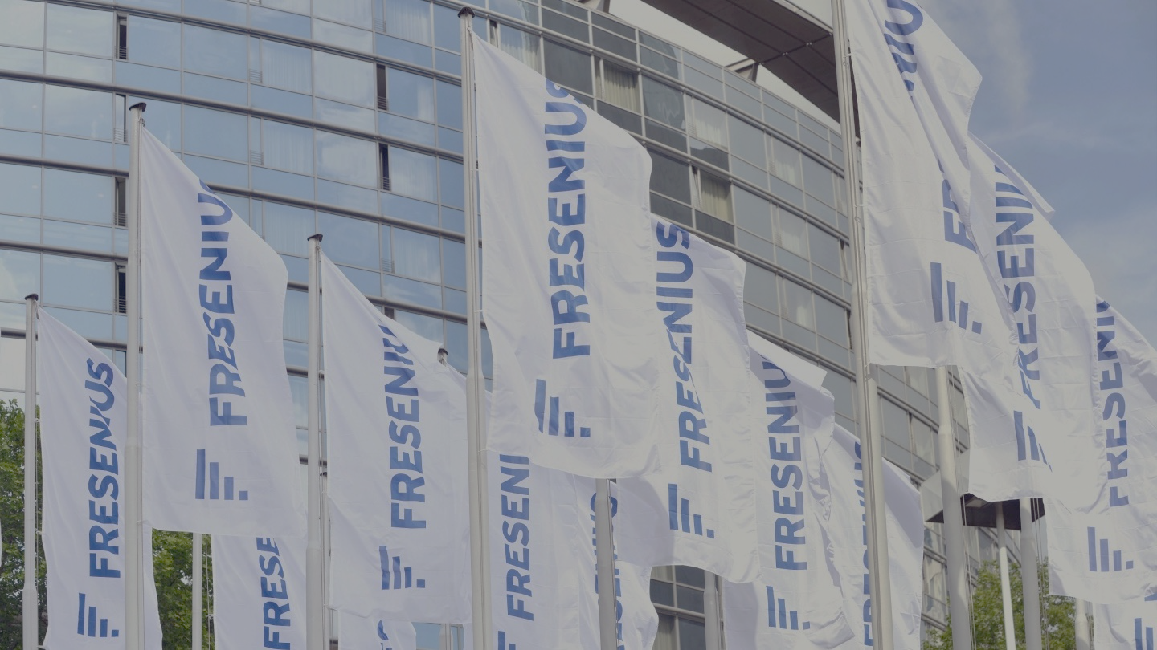
Fresenius case 2019: Outline
Fresenius is the German-based largest provider of dialysis products in the world.
In March 2019, the SEC issued a order: Fresenius settled to pay $230 million to resolve investigations related to FCPA violations for nearly a decade in Africa, the Balkans, China, Mexico, Middle-East and Spain.
FCPA applied as Fresenius is on the NY Stock Exchange and employees and agents used the “means and instrumentalities of US interstate commerce”, e.g. email accounts hosted in the US.

Slide 7
The Basic Breaches
Fresenius failed to have sufficient internal accounting controls and made improper payments through a variety of schemes, including using sham consulting contracts, falsifying documents, and funnelling bribes through a system of third-party intermediaries.

Slide 8
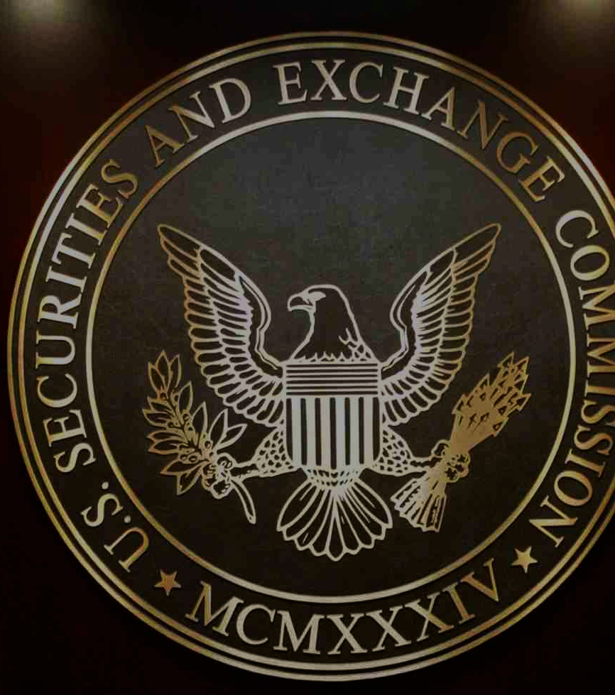
“Failure to address the corruption risks in its growing business allowed complicit managers to engage in bribery schemes that went undetected for more than a decade,” said Charles Cain, Chief of the FCPA Unit. “As companies expand their business, their internal accounting controls and compliance programs must keep up.”
“By engaging in widespread bribery schemes across multiple countries, the company prioritized profits over compliance in its dealings with foreign government officials,” said Tracy Price, Deputy Chief of the SEC Enforcement Division’s FCPA Unit.

Slide 9
Saudi Arabia
Fresenius knew of the local high risks, but failed to ensure that sufficient controls were in place.
Fresenius also failed to assign a compliance officer to the region.
In 2009, German HQ received reports from Saudi finance that the local GM submitted false invoices and knew of improper marketing and travel expenditures. This continued until late 2012 when remediation was first initiated. The GM was terminated in 2013.
Many documents were altered, destroyed and falsified. The falsification and destruction of records intensified once the internal investigation began.

Slide 10
Morocco
From 2006 to 2010, a Senior Officer in Morocco and a Sales Manager in Germany engaged in a scheme to pay bribes to a Moroccan official. Numerous red flags were overlooked including that payments were backdated and had no relevance to the Moroccan business.
In May 2013, Fresenius HQ received an anonymous complaint about improper payments related to military hospitals. Fresenius did not initiate an investigation until 8 months later.
After receiving preservation notices in 2014, some managers destroyed records and deleted files.

Slide 11
Angola
In 2011, Fresenius Angola executed a share transfer to Angolan HCPs, including military officials, signed by Fresenius senior Legal and Compliance and a Board of Management member.
In January 2012, the shares were transferred to the officials without their having paid anything in exchange and without any due diligence conducted on the transaction.
In June 2012, an audit report found that “overall controls are not functioning”.
In late 2012 Legal and Compliance asked to freeze all payments to the Distributor. Fresenius continued to accrue an additional $900K on its books for services never rendered, but ultimately was prevented from making the payment.
Fresenius Portugal misled the audit team when they tried to determine if additional relationships with the Angolan Distributor existed.
It took until end 2013 for Legal and Compliance to review the relationship with the military officials. Legal and Compliance ultimately concluded in December 2013 that these facts raised “a serious issue”.

Slide 12
Spain: Audit Ignored
In 2010, Fresenius Internal Audit found that Fresenius Spain failed to comply with the company’s policy concerning dealings with foreign officials.
In 2014, another Internal Audit report, sent to the same recipients as the 2010 report and the entire Management Board, raised significant red flags about Fresenius Spain’s payments to public officials, including a lack of documentation for payments related to gifts, donations, sponsorships, commissions, and consultancy payments.
The payments to doctors continued until 2015.

Slide 13
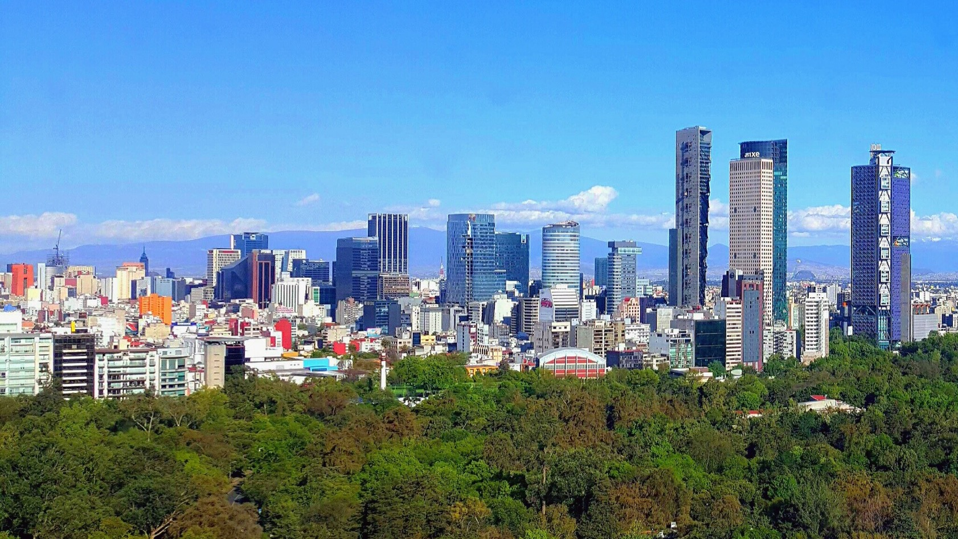
Mexico
An audit report found several issues, including insufficient evidence that a Mexican distributor rendered proper services, the contract was signed a year after services were supposedly rendered, and monetary payments were made retroactively.
Unclear if the report was promptly followed up.

Slide 14
A Potential Root Cause Analysis
Despite red flags since the early 2000s, Fresenius devoted insufficient resources to compliance / “prioritized profits over compliance”
When Compliance or other control functions detected potential issues they were ignored, delayed, mislead
Compliance or other control functions seemed to detect issues late, when detected at all
Senior management actively engaged in corruption and directed employees to destroy records of the misconduct / conceal facts

Slide 15
Conclusions
An inappropriate company culture can be the main source of compliance and ethics failure
What, as Ethics & Compliance professionals, can we do to change and elevate a company culture? How can we do it?
What shall we do in situations where we are not provided enough resources, where we are ignored, where there is no cooperation, where things are hidden from us, where we are still considered an approval function at the end of the corridor?
What duties do we have in relation to these situations? Escalate, speak up, leave?
What is our duty to identify issues and act upon them, no matter what and what is our accountability for failing?
Hopefully, these two days together will provide some productive ideas on these crucial topics.

Slide 16
Thank you!
Piergiorgio Pepe, ETHICS member, Quantum Ethics, Sciences Po

