Slide 1
2018 General Assembly
Thursday 04 – Friday 05 October
Clifford Chance Office, Paris

Slide 2
Roeland van Aelst ETHICS President

Slide 3
Agenda

Slide 4
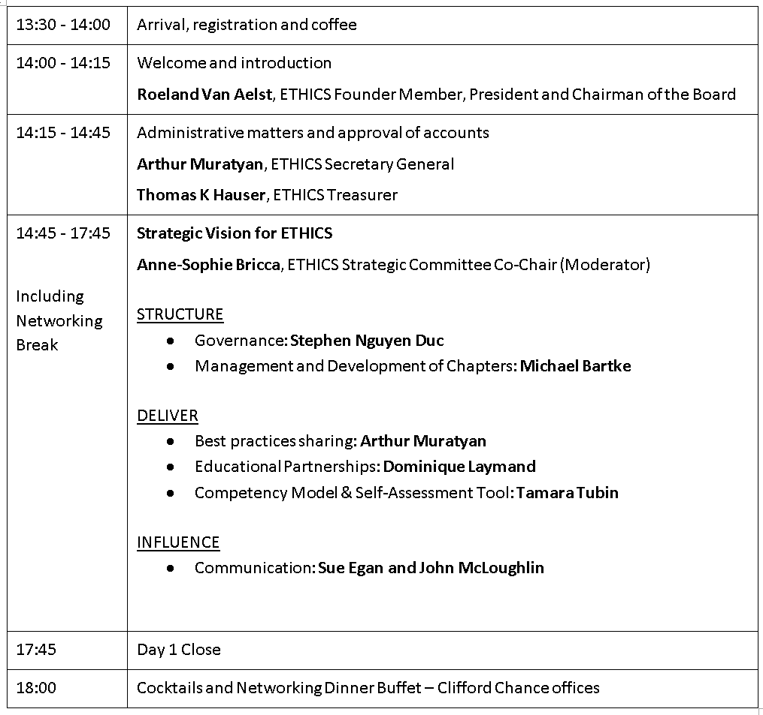
Agenda - Today

Slide 5
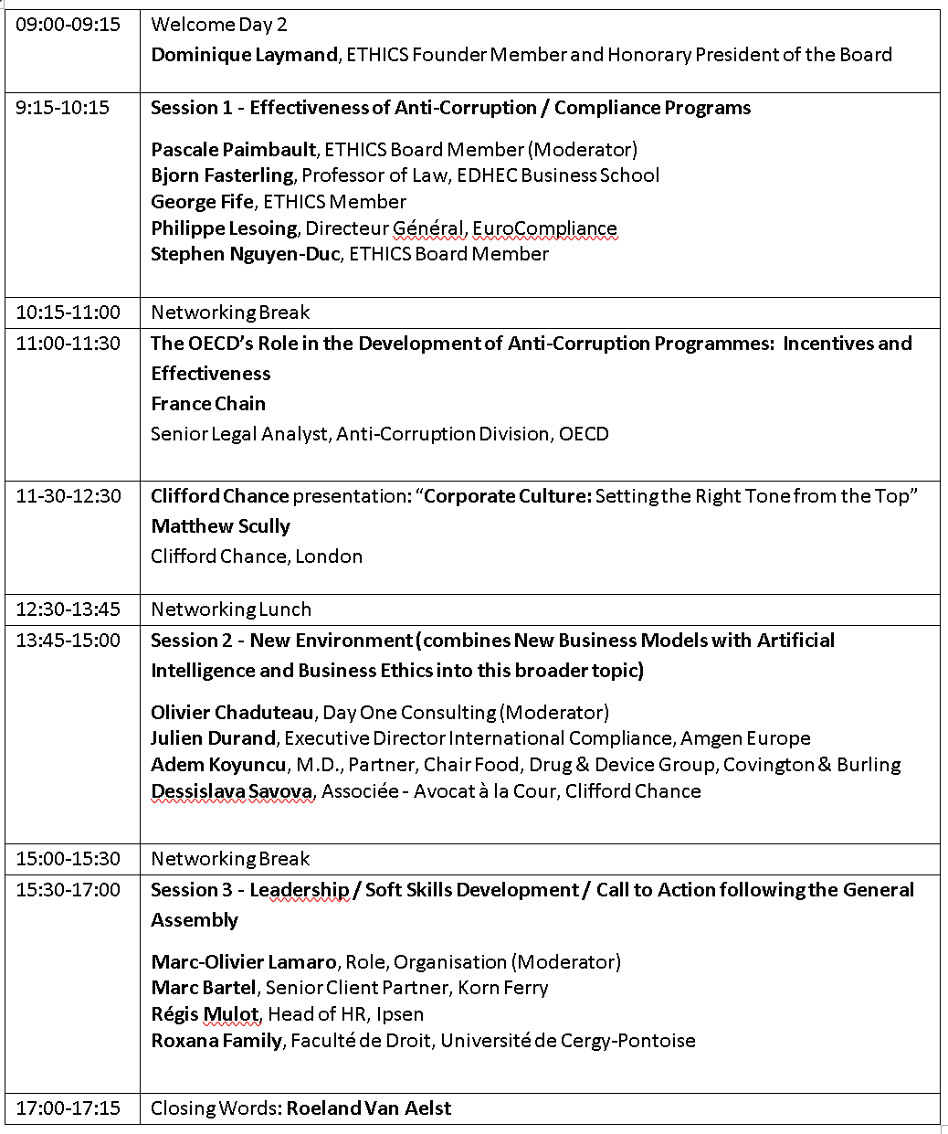
Agenda - Tomorrow

Slide 6
Thomas K. Hauser ETHICS Treasurer

Slide 7
Agenda
Purpose
General rules
Accounts 2017, Forecasts 2018, Perspectives 2019
Membership update

Slide 8
Purpose
Conformity with bylaws
Inviting all members of the Association
Submitting to your approbation
The accounting and financial results 2017
Forecast 2018 and Budget 2019
Membership update (as of September 30 2018)
Notes:
-We are today, in our 2018 Ordinary General Assembly, in conformity with the ETHICS Association bylaws and current legal generally admitted requirements,
Inviting all members of the Association,
-Submitting to your approbation the accounting and financial results of our last statutory 2017 exercise.
-From January 1st, 2017 to 31/12/2017, date of end of 3rd exercise ( as defined by our Internal Rules)
-We also present you the main on going 2018 financial actions and projects engaged
- As well as 2019 potential projects/ investments

Slide 9
General rules
The Association is made up of the following categories of members:
Founding members (Dominique and Roeland)
Contributing members (1500,00 €)
Active members (200€ till 2017, 250€ since 2018)
Honorary members
New Members profiles: Validated by the Bureau (7 Bureau members)
No Remuneration for the Bureau
Non-Profit Organization (Association Loi 1901)

Slide 10
2017 Financials
Assets and Liabilities

Slide 11
2017 Financials
Expenses & Revenues

Slide 12
2018 Forecast & 2019 Budget
Expenses & Revenues

Slide 13
Gabor Danielfy Scholarship Fund
Current balance End of September 2018 is EUR 3’000,-
This is valid for two attendees at the HCCP program at SciencesPo
Further donations to grow this fund are highly appreciated For more details please contact the Treasurer

Slide 14
Membership summary (End of Sep 2018)
23
47
58
66
78
81
88
Notes:
2018: Status of End September
11 non-payed dues
3 new members for Q4-2018/2019 4 new applications
Local Chapters not reflected in 2018

Slide 15
Starting 2019: local chapters
Starting next year, we will have a new membership category: Member of a local chapter
Activities primary in the respective country
Reduced annual membership rate of €125
No differentiation between local chapter members, active members and contributing members:
invitation to the General Assembly in Paris
full access to all Social Media, Newsletters, etc.

Slide 16
Arthur Muratyan ETHICS Secretary General

Slide 17
ORDINARY GENERAL MEETING
4 October 2018

Slide 18
RESOLUTIONS
First Resolution: Approval of the annual accounts of the financial year ended on Dec 31, 2017
Second Resolution: Result of the last financial year does not require any allocation
Third Resolution: Renewal of the mandate of Mr. Stephen Nguyen Duc as a member of the Board
Fourth Resolution: Power granted for legal formalities

Slide 19
Name, surname of the board members after the holding of the Ordinary General Meeting dated 4 October 2018: | Duties expiring at the time of the approval of the acounts of the financial year ending on:
Mr Roeland Van Aelst | Founding member - Ex officio member
Mrs Dominique Laymand | Founding member - Ex officio member
Mr Stephen Nguyen Duc | 31 December 2020
Mr Dave O'Shaughnessy | 31 December 2018
Mr Thomas Hauser | 31 December 2018
Mr Arthur Muratyan | 31 December 2018
Mrs Pascale Paimbault | 31 December 2018
Mrs Tamara Tubin | 31 December 2019

Slide 20
40916-3-2907

Slide 21
ETHICS Strategic Vision (Includes Networking Break)

