Slide 1
2018 General Assembly
Friday 05 October
Clifford Chance Office, Paris

Slide 2
Dominique Laymand ETHICS Honorary President

Slide 3
ETHICS Vision
“We aim to be recognized as an independent international association of professionals, which sets standards of Ethics and Compliance and shapes and influences strategies in the changing Healthcare environment for the ultimate benefit of Patients and Society at large.”

Slide 4
ETHICS Mission
We are a visible and transparent network and a think tank of diverse International Ethics and Compliance professionals in the Healthcare sector
We add sustainable value to Ethics and Compliance professionals by enabling them to manage their professional responsibilities and supporting them in the development of their careers
We are developing and sharing best practices to anticipate and facilitate new business models in the healthcare sector including through effective education and training, closer collaboration between Medtech and Pharma and other initiatives
We are delivering Ethics and Compliance perspectives to multiple external Healthcare sector stakeholders, as well as to Ethics and Compliance professionals from other sectors
We are an independent, not-for-profit association governed by a Code of Conduct

Slide 5
Agenda

Slide 6
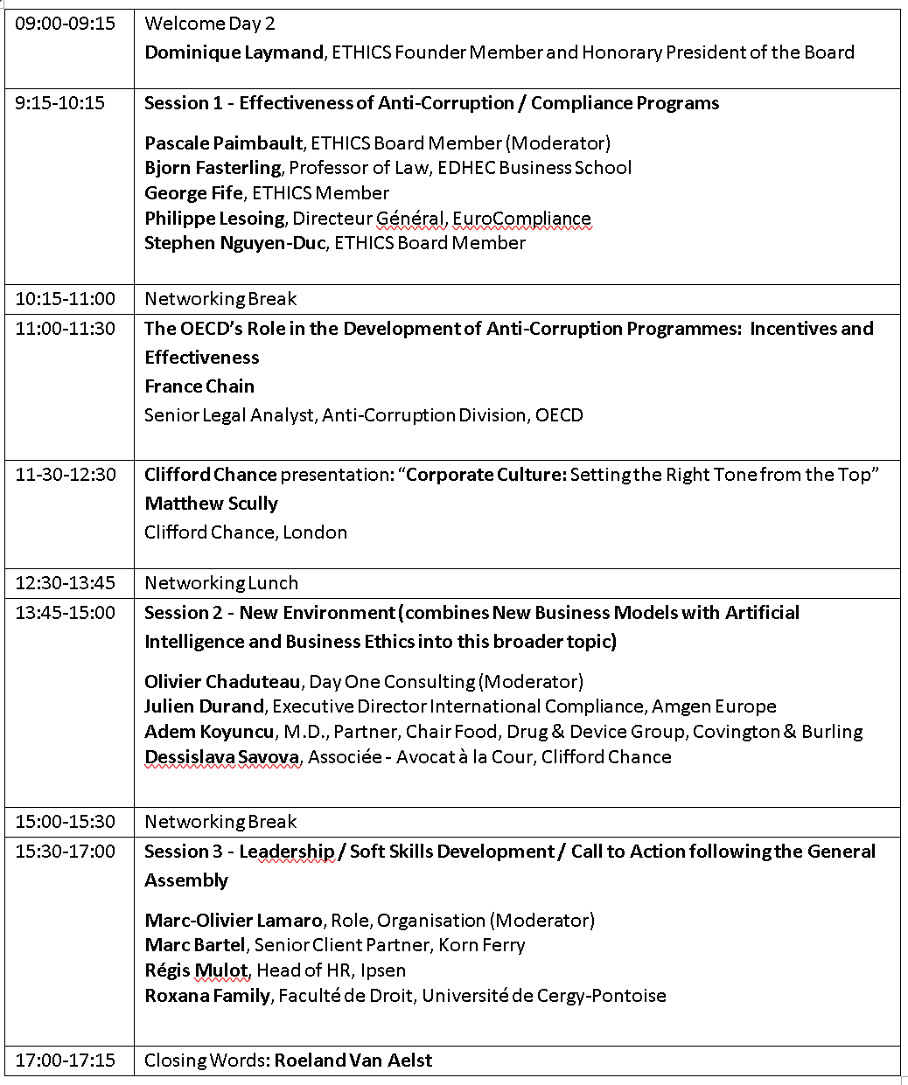
Agenda - Tomorrow

Slide 7
Effectiveness of Anti-Corruption / Compliance Programmes
Moderator: Pascale Paimbault
Panel:
Björn Fasterling, George Fife, Philippe Lesoing, Stephen Nguyen Duc

Slide 8
Networking Break

Slide 9
New Environment
Moderator: Olivier Chaduteau
Panel: Julien Durand, Adem Koyuncu, Dessislava Savova

Slide 10
Networking Break

Slide 11
France Chain
The OECD’s Role in the Development of Anti-Corruption Programmes: Incentives and Effectiveness

Slide 12
Matthew Scully
Corporate Culture:
Setting the Right Tone from the Top

Slide 13
Networking Lunch

Slide 14
Leadership Skills workshop
Leads: Marc-Olivier Lamaro, Stephen Nguyen Duc, Zoë Buch
Panel: Roxana Family, Régis Mulot, Marc Bartel

Slide 15
WORKSHOP EXERCISE (30 mins)
Discussion groups will review ONE topic each
Each topic has 3-4 questions and points to consider
Capture your key discussion points, thoughts, suggestions & solutions
Appoint a speaker to represent your group
PANEL DISCUSSION (45 mins)
Each speaker will be invited to share top 1-2 points in plenary
- Can present ideas for discussion or questions for the panel
Panellists will share their expertise, insights & advice on each topic

Slide 16
Round Table Discussion
Follow Nancy Kline’s “Thinking Environment”
Appoint time keeper
1 volunteer to start the discussion
Take turns, in order, until everyone has spoken
Each person has 2 minutes to speak – equal air time
Listen to each other, do not interrupt, follow the circle
Build on each thought “AND” instead of “But”
For more information on Thinking Environment https://www.youtube.com/watch?v=wutIaSf37lI

Slide 17
Topic 1 Topic 2
Self confidence and courage, ready to raise concerns
Has self-awareness, willingness to learn and adapt if needed
Topic 3 Topic 4
Delegates & empowers others to create proper level of accountability
Manages complexity and ambiguity
Topic 5
Facilitates development of relevant company competencies

Slide 18
TOPIC 1
Is it a matter of attitude or personality? How to develop this skill if not present yet?
How to make this aligned and compatible with the Company culture?
When recruiting Compliance personnel, how do you assess and predict this attribute?
How to create the environment where people feel able to raise concerns?
Self confidence and courage, ready to raise concerns
Consider:
Investigations
Hotline

Slide 19
TOPIC 2
Is it a matter of attitude or personality? How to develop this skill if not present yet?
How to stay connected to the business & maintain credibility with our stakeholders as trusted business partners?
How to develop good listening skills, appropriate for many different stakeholders and situations?
How to ask for, & receive, feedback to identify areas for improvement?
Has self-awareness, willingness to learn and adapt if needed
Consider:
Business understanding

Slide 20
TOPIC 3
Is it a matter of attitude or personality? How to develop this skill if not present yet?
What is important to consider before delegating to others?
How do you manage roadblocks (i.e.resistance)?
How do you know whether the expected level of accountability is reached?
Delegates & empowers others to create proper level of accountability
Consider:
Development of ownership of Compliance
Compliance team
Business team

Slide 21
TOPIC 4
Is it a matter of attitude or personality? How to develop this skill if not present yet?
How do you know that you have made improvements?
What practical tips can you share on ways to manage complexity, change and ambiguity?
Manages complexity and ambiguity
Consider:
Taking decisions in the grey zone

Slide 22
TOPIC 5
Who can help you in your Company?
How do you choose internal versus external resources (e.g. Providers)?
How can ETHICS competency model help to identify gaps?
What strategies and approaches do you use for your personal development and your team?
Facilitates development of relevant company competencies
Consider:
Capability gap identification and solutions (e.g. Training)

Slide 23
Topic 1 Topic 2
Self confidence and courage, ready to raise concerns
Has self-awareness, willingness to learn and adapt if needed
Topic 3 Topic 4
Delegates & empowers others to create proper level of accountability
Manages complexity and ambiguity
Topic 5
Facilitates development of relevant company competencies

Slide 24
Roeland van Aelst ETHICS President

Slide 25
2018 General Assembly
THANK YOU
Safe journey home!

