Slide 1

20 years of The OECD
Anti-Bribery convention
Impact on
anti-corruption compliance
ETHICS General Assembly 2018
France Chain
Senior Anti-Corruption Analyst,
OECD Anti-Corruption Division
The views expressed in this presentation do not necessarily represent those of the OECD member countries or States Parties to the OECD Anti-Bribery Convention.

Slide 2
Impact of the Anti-Bribery Convention on Anti-Corruption Compliance
Introduction: The Anti-Bribery Convention and
the Working Group on Bribery
  Liability of legal persons:
  What this means for compliance?
  Resolution of foreign bribery cases: the value of compliance models
  Foreign bribery cases in the healthcare sector: compliance as a solution or a problem?

Slide 3
The OECD Anti-Bribery Convention
Who?
The Working Group on Bribery: 36 + 8
  Non-OECD: Argentina, Brazil, Bulgaria, Colombia, Costa Rica, Peru, Russian Federation, South Africa
  Includes emerging economies (Argentina, Brazil, Chile, Israel, South Africa, Turkey)
All G20 members except China, India, Indonesia, Saudi Arabia
Notes:
50% of world exports (2009)
64% of global outward flows of foreign direct investment
Home to 95 of the 100 largest non-financial multinational enterprises and all of the top 50 financial multinationals

Slide 4
The Anti-Bribery Convention and the Working Group on Bribery
Anti-Bribery Convention and related instruments:
  2009 Anti-Bribery Recommendation
  “Thematic” Recommendations: Tax Measures for Combating Foreign Bribery; Official Development Assistance; Export Credits
Country monitoring

Slide 5
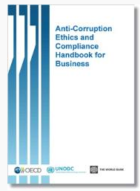
OECD anti-bribery instruments:
Compliance standards
2009 Anti-Bribery Recommendation:
Recommendation X:
  Development of internal controls and compliance measures
  Considering these in decisions
  to grant public advantages
Annex II: Good Practice Guidance
+ Handbook

Slide 6

I - Liability of legal persons and impact on compliance standards
The Liability of Legal Persons for
Foreign Bribery:
A Stocktaking Report (2016)
Over 2 600 data points
41 Parties to the OECD Anti-Bribery Convention
Nearly 200 WGB monitoring reports
Updated through 1 July 2016

Slide 7
Nature of legal person liability
Source: OECD (2016), Stocktaking Report, Figure 1.

Slide 8
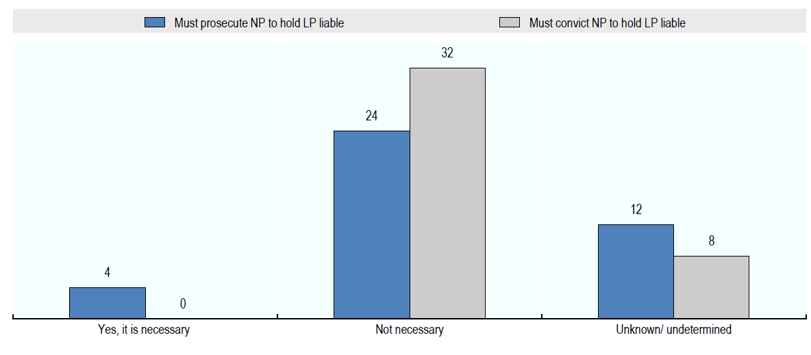
Are proceedings against natural persons required for LP liability?
Source: OECD (2016), Stocktaking Report, Figure 5.

Slide 9
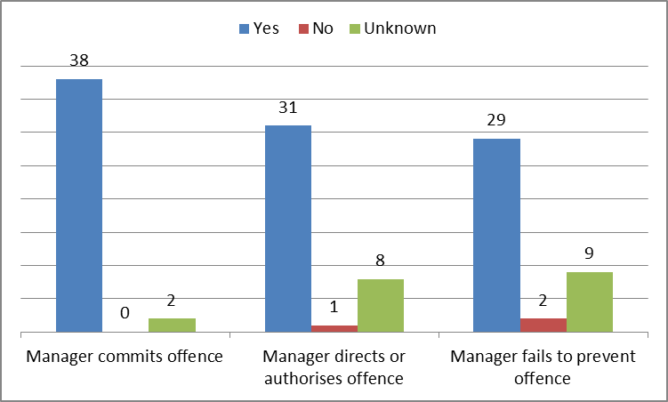
Liability for whose acts?
Source: Data extracted from OECD (2016), Stocktaking Report, Table 4.

Slide 10
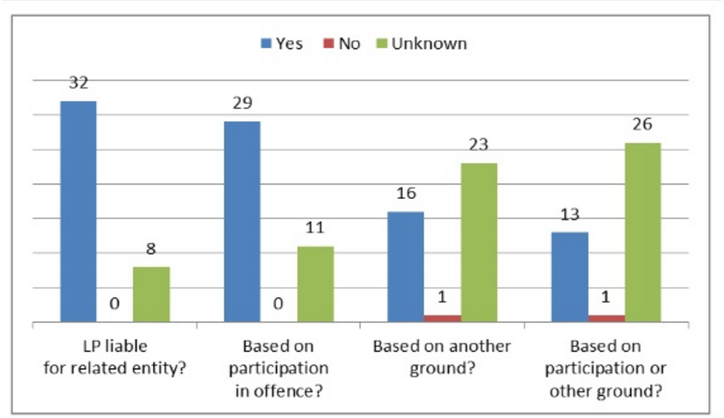
Liability for related legal persons?
Source: Data extracted from OECD (2016), Stocktaking Report, Table 8.

Slide 11
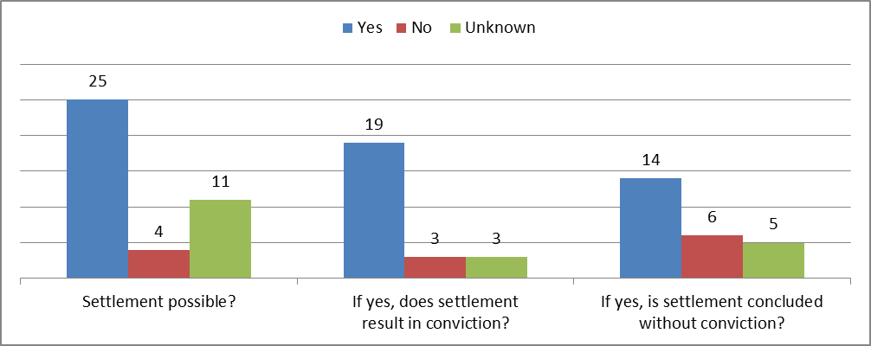
Incentives for detection or collaboration:
Availability of settlements
Source: OECD (2016), Stocktaking Report, Figure 10.

Slide 12
Can compliance systems preclude liability?

Slide 13
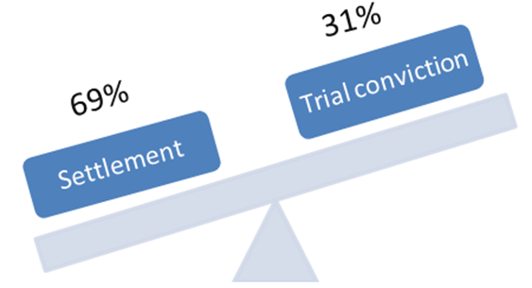
II - Settlements in foreign bribery cases
Upcoming OECD study
“In reality, the court assessment of the facts matters less than a broader view of the situation. The settlement instrument is also about other people, other practices, and, in the end, about the entire corporate culture”
Astrid Mignon Colombet, Lawyer, on the first French Convention Judiciaire d’Intérêt Public
“Not only are settlements a pragmatic and efficient way to resolve cases that would otherwise require tremendous time and resources, but handled correctly they advance the public interest and promote compliance.”
Robert Sikellis, Chief Counsel Compliance, Siemens
Ongoing study covering
23 Convention countries with settlements procedures
Release: March 2019

Slide 14
Imposing compliance through settlements
51% of the settlement systems allow compliance requirements
38% allow for appointment of a corporate monitor
Systematic use in practice
“ We are able to impose reforms, impose compliance controls, and impose all sorts of behavioural change that a court would never be able to impose following conviction at trial. ”
Leslie Caldwell, US Assistant Attorney General

Slide 15
Imposing compliance through settlements
1 - Remedial measures
Change line of business
Replace corporate board members or management
Create or enhance its compliance programme
Periodic reports concerning compliance
Corporate monitorships

Slide 16
Imposing compliance through settlements
2 – Focus on corporate monitors
Only 1/3 of countries can impose monitors
Appointment of monitor:
  Not fixed
  By defendant
  By defendant and prosecutor jointly
  By enforcement authority
Duration: fixed / indeterminate
Monitor’s duties:
  Periodic reports to assess compliance
  Identify shortcomings
  Observing the implementation of recommendations
  Reporting to authorities

Slide 17
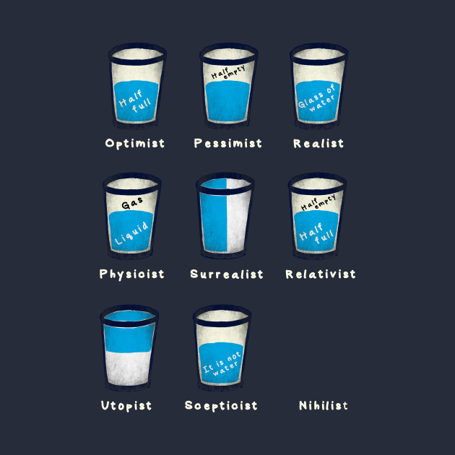
Imposing compliance through settlements
Does it work?

Slide 18

III - Foreign bribery in the healthcare sector:
Compliance as a problem or a solution?

Slide 19
Foreign bribery in the healthcare sector:
What offence?
Purpose of the bribery: increase products sales and prescriptions
False recording of corrupt payments in books and records
Failure to devise and maintain an adequate system of internal accounting controls
Failure to apply their compliance and due diligence policies to detect and prevent bribery schemes
Lack / deficiencies in their compliance programs
Failure to monitor third party payments
Inadequate position of compliance officer and/or compliance department
No monitoring of improper payments
No remediation in compliance gaps

Slide 20
Foreign bribery in the healthcare sector:
Factors in sentencing
Self-reporting
Full cooperation and internal investigation
Prompt and voluntary remedial efforts, including:
  Compliance programme
  Internal controls
  Enhanced compliance functions
  Update to due-diligence procedures
  Enhance anti-corruption training
  Compliance assessments
  Audits of third party distributors and sales agents
  Strengthening of risk-assesment tools

Slide 21
Foreign bribery in the healthcare sector:
Remedial measures imposed
Monetary penalty + disgorgement of profits
Enhanced compliance programmes
Independent compliance monitor
Regular report to law enforcement
New missions for compliance functions

Slide 22

To Find Out More
www.oecd.org/corruption
france.chain@oecd.org

