Slide 1
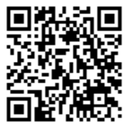
Think Tank
Networking / Sharing Experiences
Education & Professional Development
Communication
ETHICS Vision
“We aim to be recognized as an independent international association of professionals, which sets standards of Ethics and Compliance and shapes and influences strategies in the changing Healthcare environment for the ultimate benefit of Patients and Society at large.”
Web: www.ethicspros.com
Email: contact@ethicspros.com
Scan the code to join (or click “Join” on our website):

