Slide 1
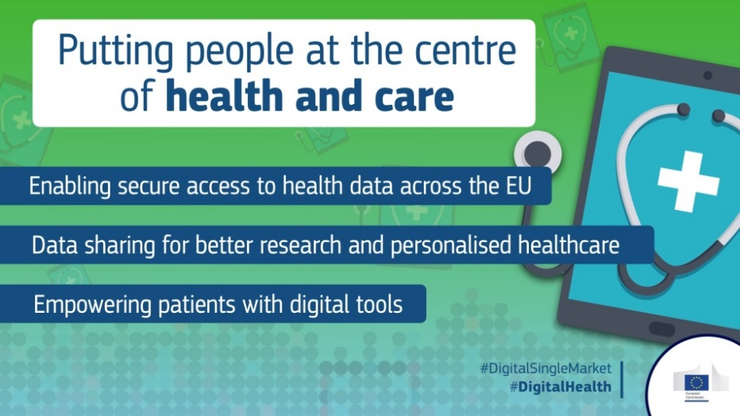
eHealth in Europe: the Digital Transformation of Health and Care
Ceri Thompson, DrPH
Deputy Head of Unit
Unit H3, eHealth, Well Being and Ageing
Directorate H Digital Society, Trust & Cybersecurity
DG Communications Networks, Content and Technology (DG CONNECT)

Slide 2
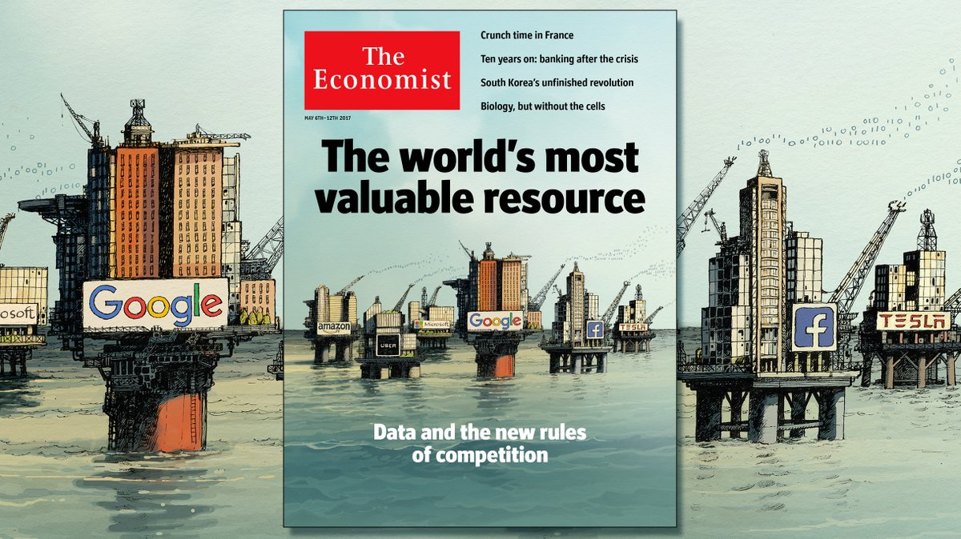

Slide 3
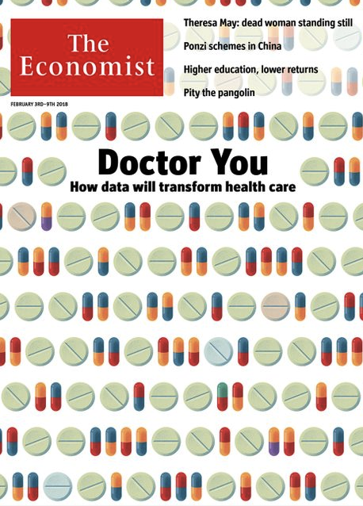
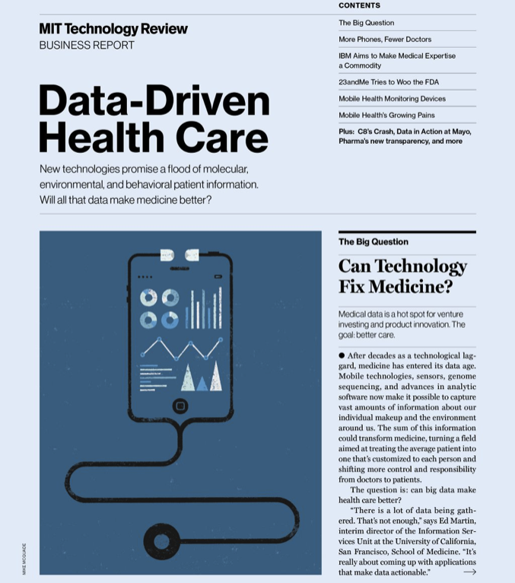
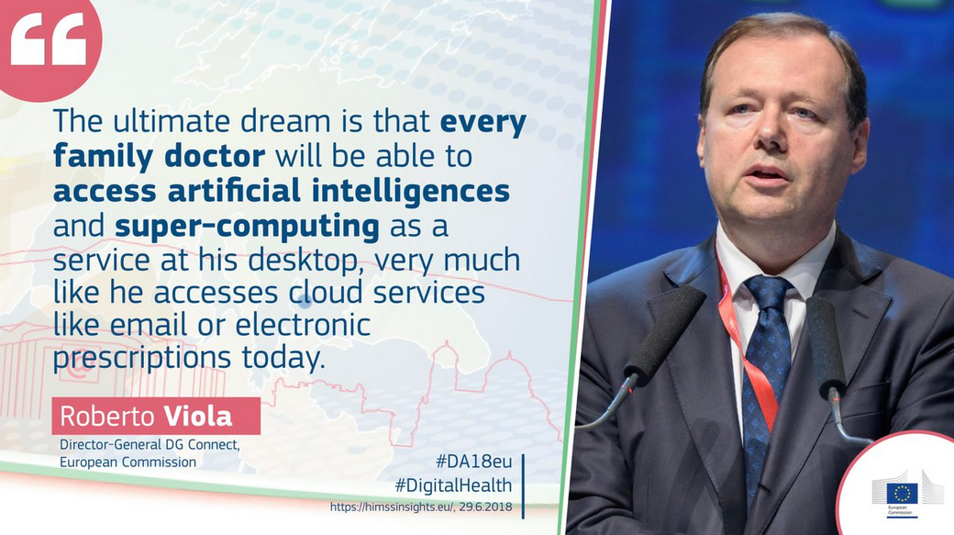
Future = Data-driven Health & Care

Slide 4
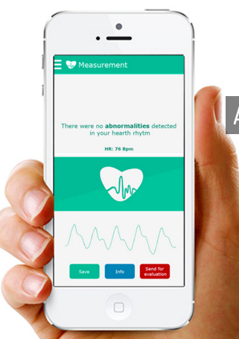

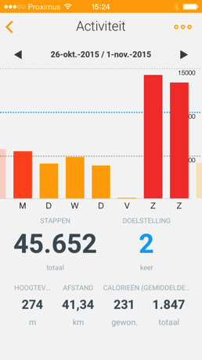
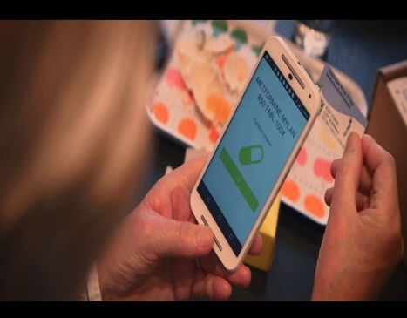
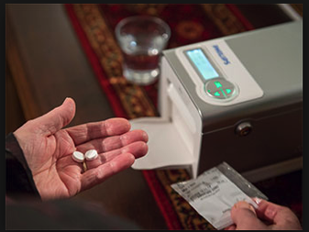
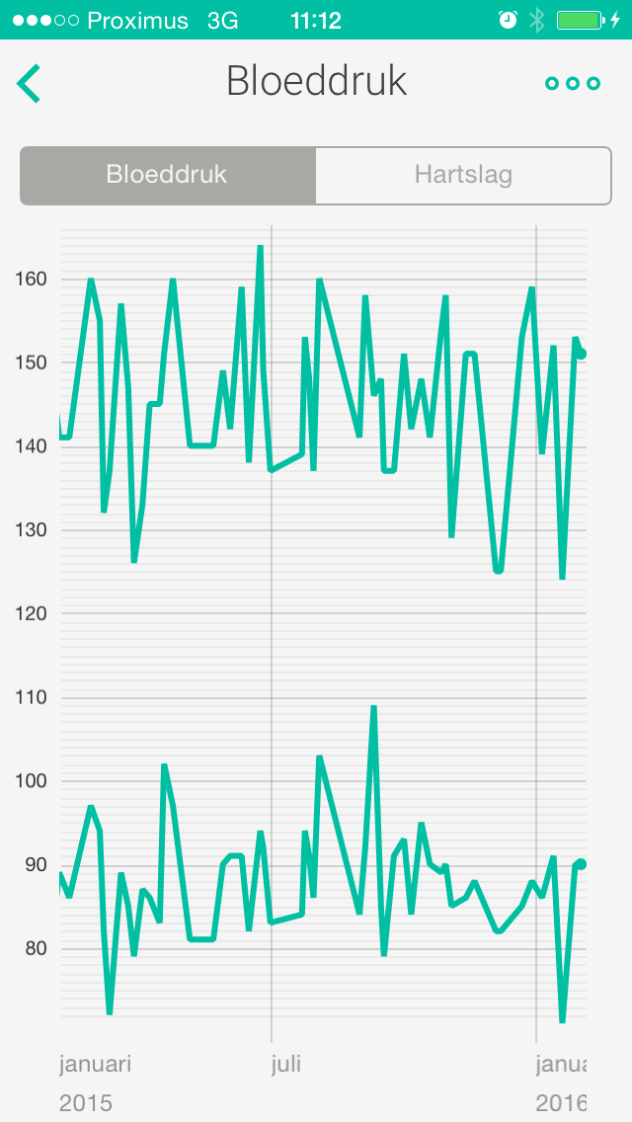
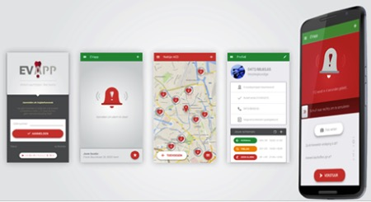
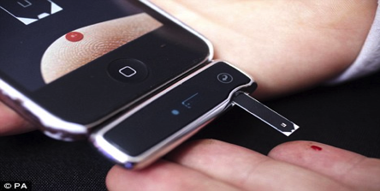
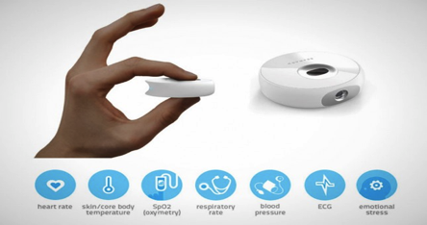
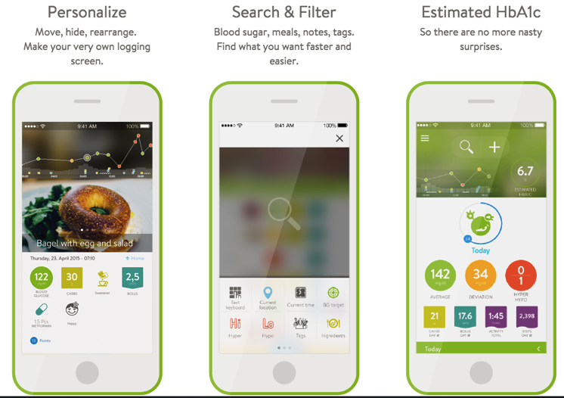
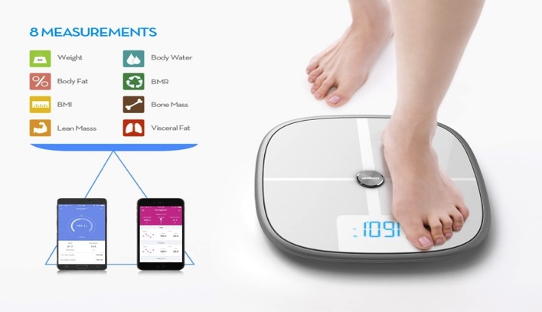
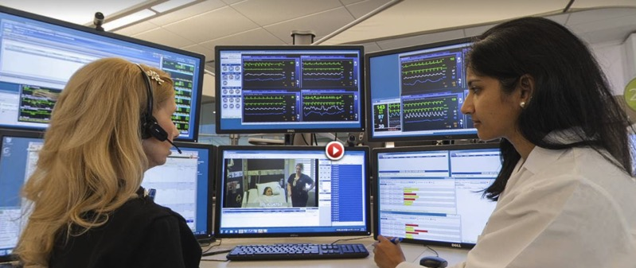
Don’t Worry, be appy
Notes:
Withings, EVApp, Qompium, Scanadu, Clinic, MySugr, Zembro, Philips Medido, Mercy Virtual

Slide 5
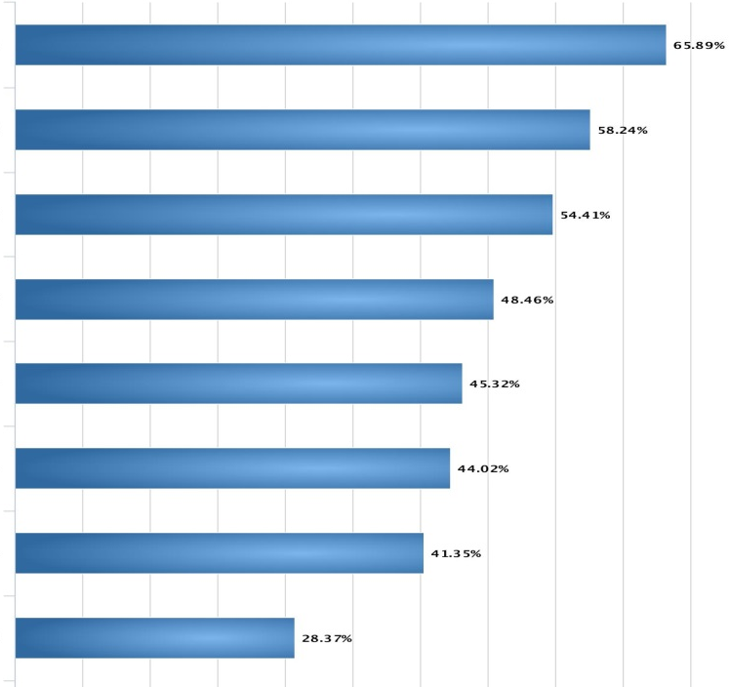
Open Public Consultation
Risk of privacy breaches
Heterogeneity
electronic health records
Cybersecurity risks
Data quality and reliability
Lack of infrastructure
Legal restrictions in member states
Lack of awareness
Lack of interest
"What are the major barriers to electronic sharing of health data?"

Slide 6

Commission Communication COM (2018) 233
Digital transformation of health and care
in the Digital Single Market
empowering citizens and building a healthier society

Slide 7
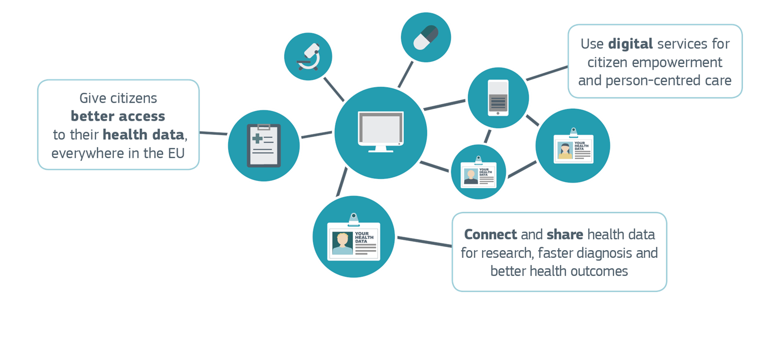
Digital Transformation of Health and Care

Slide 8
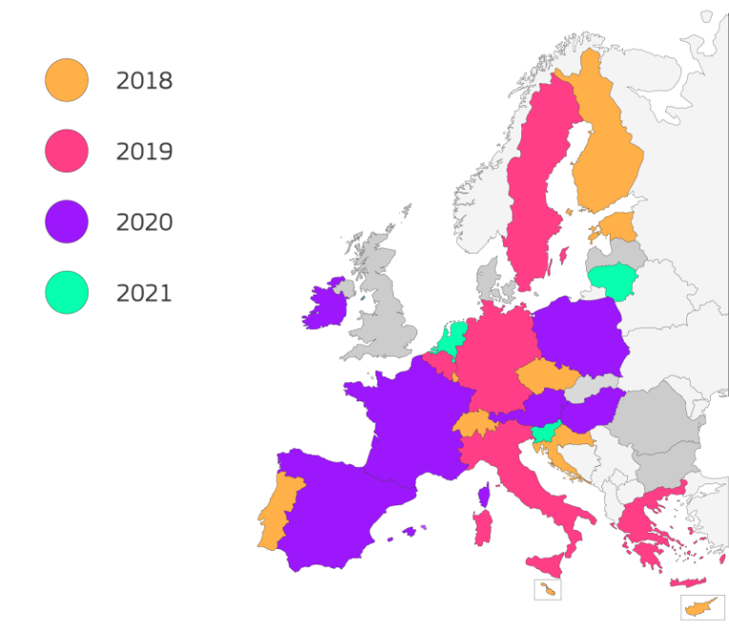
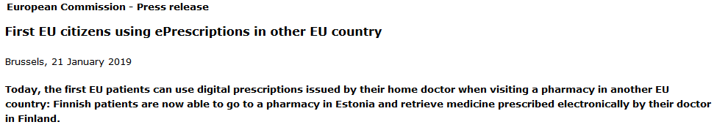
(I) Giving citizens better access to their health data
The eHealth Digital Service Infrastructure (eHDSI) enables exchange of patient data across borders
Patient Summary provides access to health professionals to verified key health data of a patient during an unplanned care encounter while abroad
ePrescription enables patients to receive equivalent medication while abroad to what they would receive in their home country
Notes:
Patient Summary (as described in the eHN guidelines and updated by the eHDSI)
ePrescription (as described in the eHN guidelines and updated by the eHDSI)
Laboratory results
Medical imaging information
Discharge letters/summaries

Slide 9
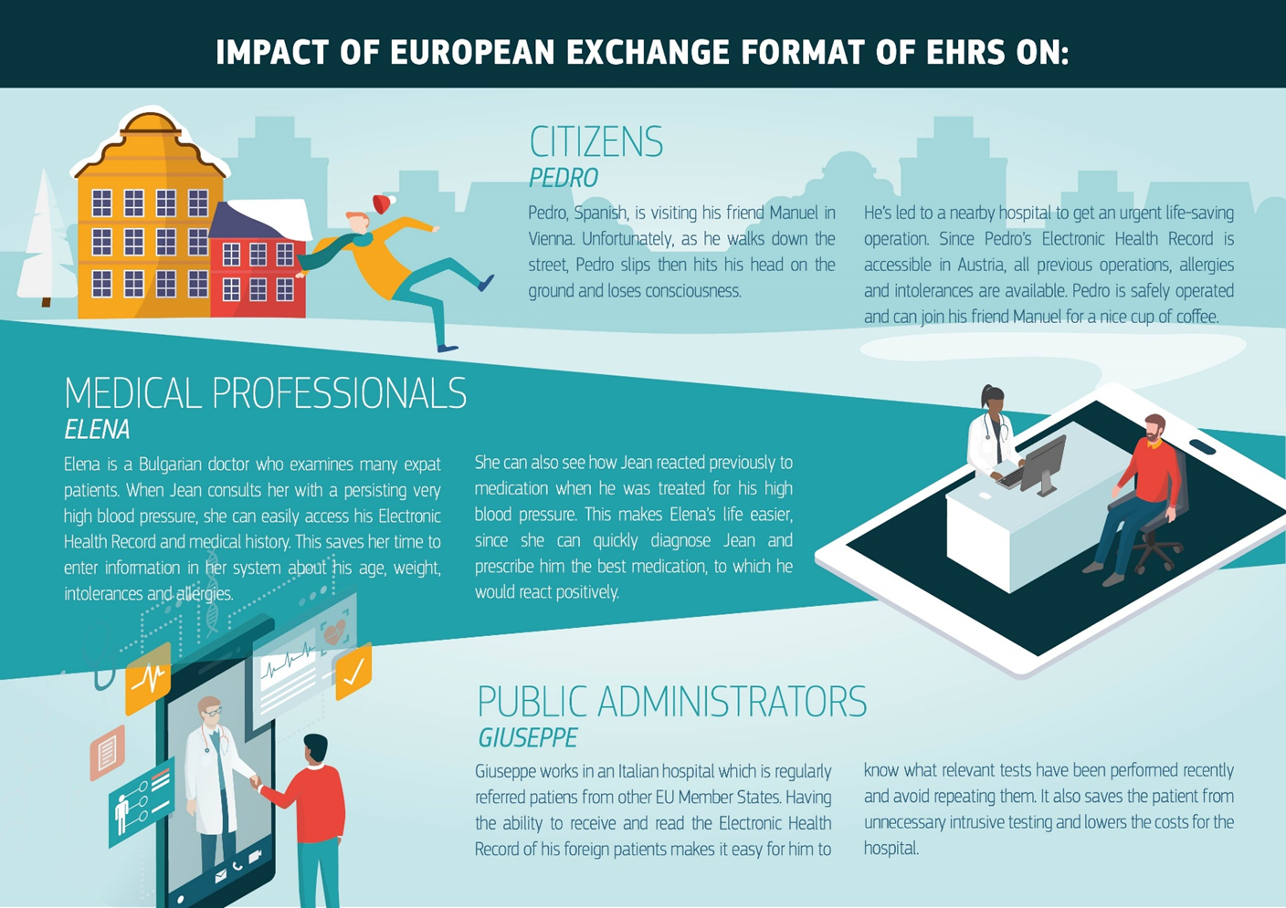
Notes:
EC encourages and support MS to adopt interoperable electronic health records systems
Recommendation European Electronic Health Record exchange format

Slide 10
Recommendation on a European Electronic Health Record exchange format ((C(2019)800) of 6 February 2019)
  Moves on from the initial set of health information domains: patient summaries, ePrescriptions and proposes work now starts on laboratory reports, medical images and reports, and hospital discharge reports
  Sets down a baseline of interoperability specifications (existing standards and profiles) in the 5 areas above
  Proposing a coordinated approach to taking forward this work involving Commission, Member States and Stakeholders
  Encourages MS to further digitize health records and to involve cybersecurity and data protection authorities

Slide 11
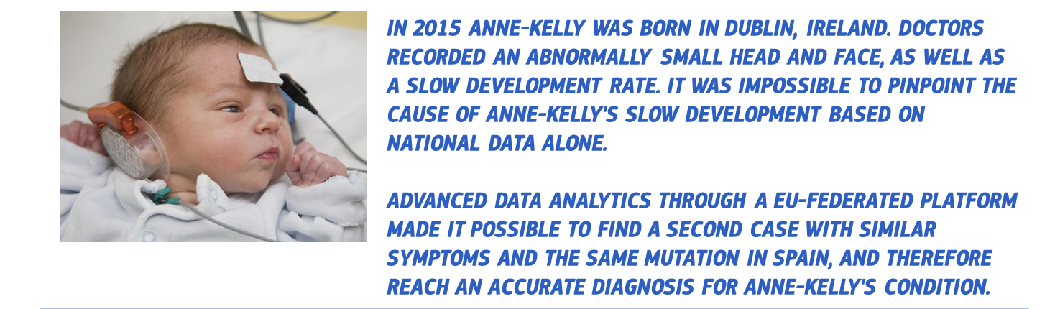
Health Data
(II) Connecting health data for research and personalised medicine
Big data & artificial intelligence
New approaches to prevention, diagnosis & treatment
Rare diseases are an early use case

Slide 12
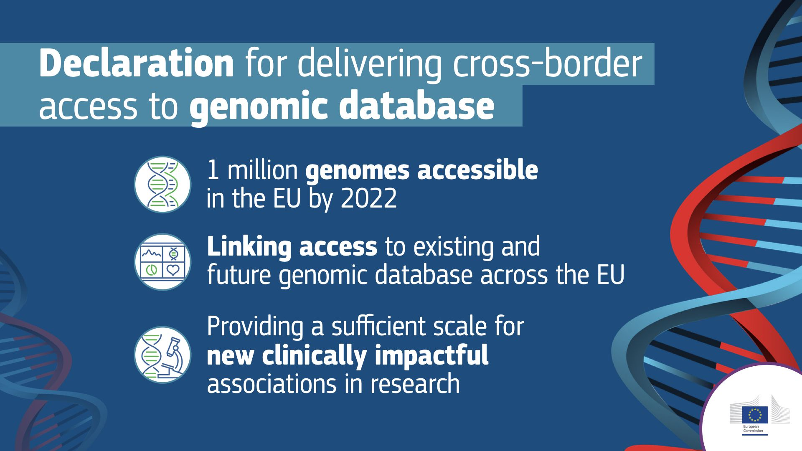

Slide 13


EU strategy for AI
A STRATEGY FOR EUROPE TO LEAD THE WAY
Boost technological and industrial capacity & AI uptake
Ensure an appropriate ethical & legal framework
Prepare for socio-economic changes

Slide 14
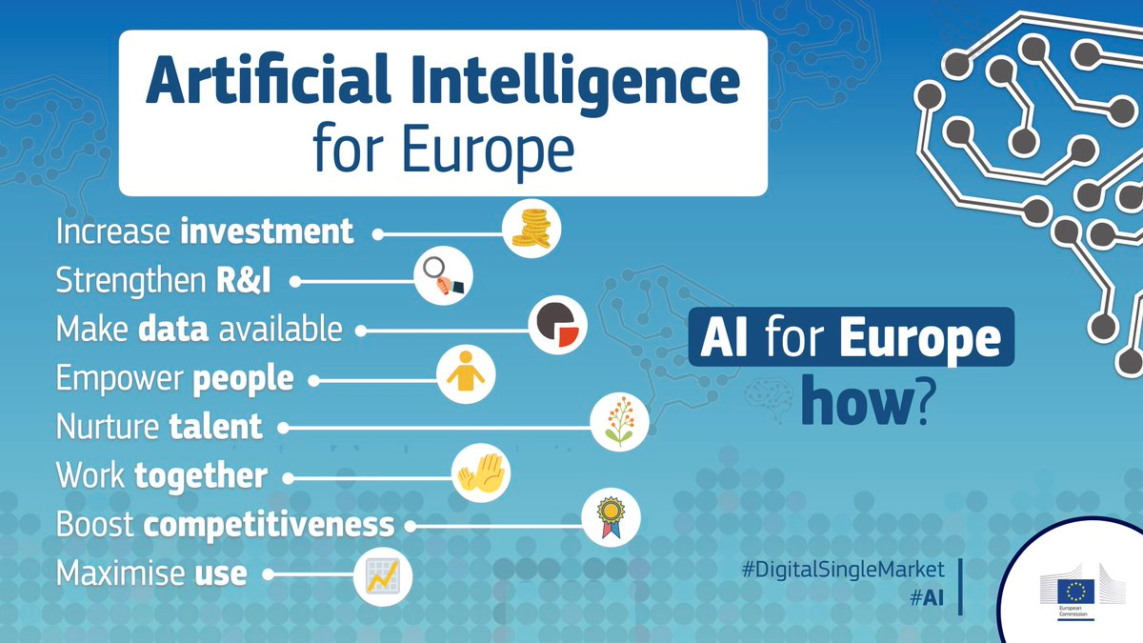
Communication Artificial Intelligence for Europe

Slide 15
Key challenges
  Transparency and accountability– explain AI, mitigate bias,
  increase trust
  Data protection and security – consent, protect sensitive data
  Safety and liability – ensure data quality, increase reliability, sort
  out responsibilities
  Ethics and governance – ensure privacy and adequate
  management of data and processes
  Expertise and digital skills – train workforce and digital literacy

Slide 16
HLEG-AI
Guidelines for Trustworthy AI
  Seven key requirements
    Human agency and oversight
    Technical robustness and safety
    Privacy and data governance
    Transparency
    Diversity, non-discrimination and fairness
    Societal and environmental well-being;
    Accountability
  Assessment list - piloting phase

Slide 17
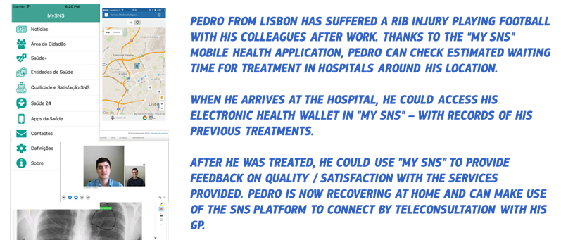
(III) Digital tools to foster citizen empowerment and person-centred care
Deployment of digital services, capacity building
Common principles for validation and certification
Mobilise investments

Slide 18

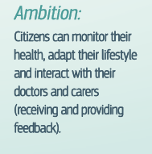
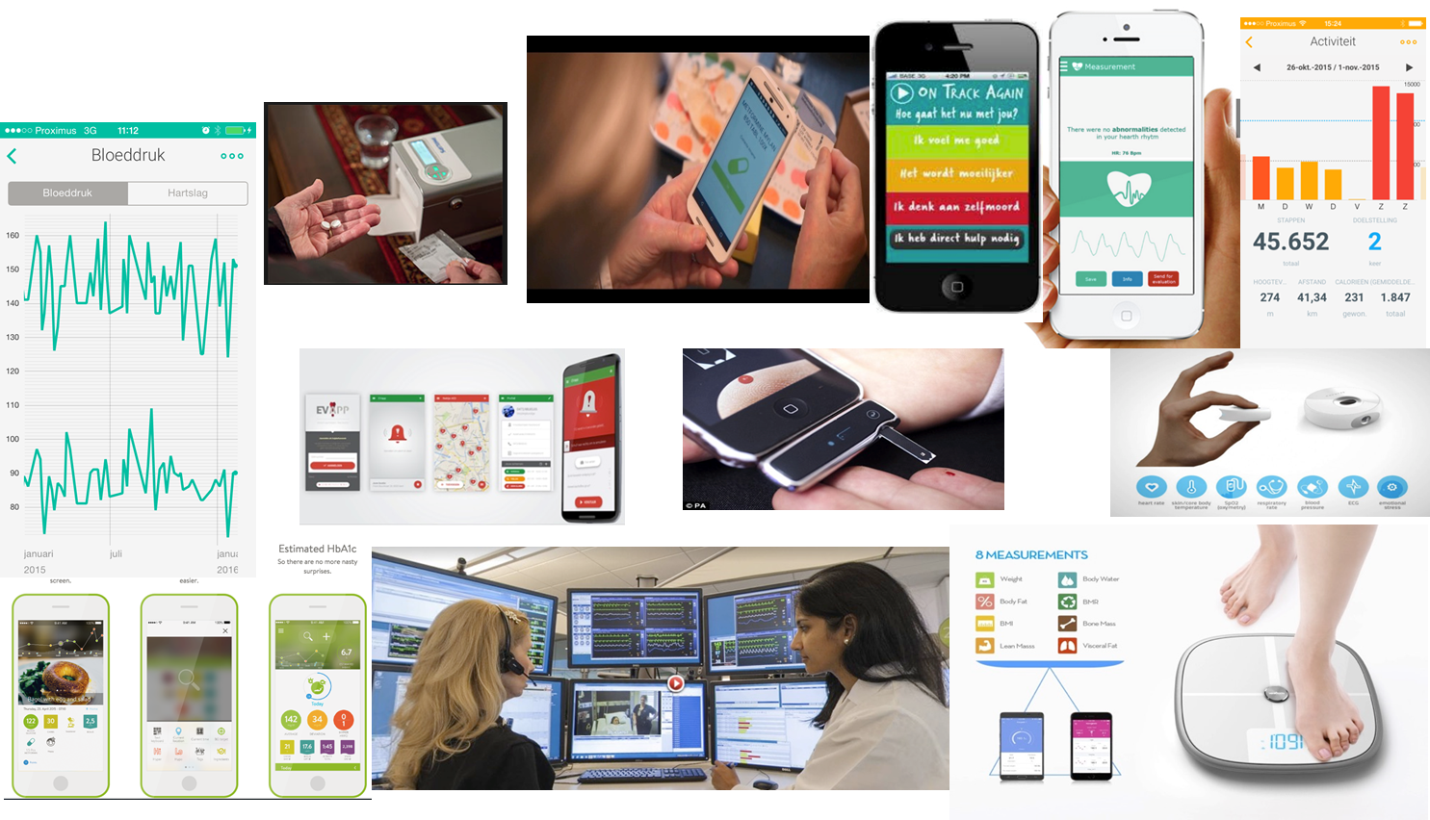
ACTIONS
  Facilitate the wide deployment of digitally-enabled services
  Promote common principles for validating and certifying health technology
  Capacity building and technical assistance for health authorities to scale-up best practices
  Mobilising investment to support large-scale implementation of digitally enabled, integrated, person-centred care models

Slide 19




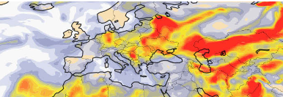

Common European Data Space
Rich pool of available data (open and closed)
Large data spaces per sector
Health
Free flow of data across sectors and countries
Industry
Agriculture
Transport
Data Governance (GDPR, data sharing)
Data platforms
Pooling and sharing
Cloud storage
Interoperability
High-value data sets from the public sector
Notes:
Access to relevant and high-quality data is widely recognised to be one of the crucial elements in building a data-driven economy and growing in particular an AI economy in Europe.
In the Communication ‘Towards a common European data space” of 24 April 2018 the Commission defined the vision of a ‘common European data space’ as “a seamless digital area with the scale that will enable the development of new products and services based on data”.
Our Vision of a European common data space is based on three main components:
Rich pool of data available for re-use. The data could be open (e.g public sector data) but also closed (data held by the private sector, or personal data).
Free flow of data across sector and countries
Data Governance (access and use should be granted in full respect of existing legislation such as GDPR)
Within the European Common Data Space, through DEP we will support the creation of sectorial large data spaces contributing to the development of industrial and personal data platforms including the take up of cloud based infrastructures, promoting the pooling and sharing of data and the adoption of standards.
At the same time we will work closely with the MS to identify a number of High Value data set held by the public sector that will be made available for free for reuse. These datasets will include for example geospatial and meteorological information which are the backbone data for sectors like agriculture, transport, smart city.
Finally we will support the development of a European data economy by supporting through incubators startups and SMEs to access to the such large data spaces.
Background:
The Large data spaces will be based and build upon:
Industrial data platforms for B2B data sharing:
- Adopting non-proprietary standards that do not lock in companies into a specific proprietary ecosystem;
- Ensuring trust between data provider and data user;
- Ensuring compliance with legislation (data protection, IP protection, trade secrets).
Specific industrial data platforms for generating pools of high-quality data useful for machine learning:
- Aggregating demand, in particular from SMEs;
- Ensuring trust between data provider and data user;
- closed setting so that companies decide with whom to share;
Personal data platforms
They are three-sided platforms that need to create network effects by ensuring enough data supply, data demand (data users, personal data application developers) and an active individual that starts using such platforms.
Such platforms can play a role in consumer empowerment, making them active agents in the data economy.

Slide 20





Funding opportunities digital health 2021-2027
Digital Europe Programme Horizon Europe
and Connecting Europe Facility
European Social Fund + European Regional
and European Globalisation Development Fund Adjustment Fund
InvestEU Programme

Slide 21
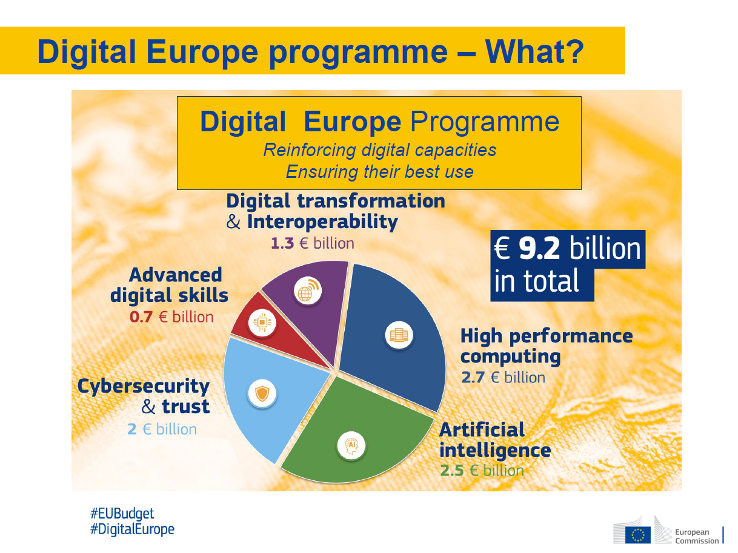
Notes:
There is new political will to cooperatively address what were previously domestic concerns
The EU is in a unique position to plan, jointly finance, and coordinate actions on a scale capable of meeting the illustrated challenges, and ensure that the benefits of new digital technologies are fully shared - not reaped exclusively in a few Member States.
Coordinated public investments at the EU level are essential:
to serve areas of public interest across the EU (from health to mobility and environment)
for the public sector (over 50% of GDP) to act as first mover in acquiring latest digital technologies benefiting our citizens while reinforcing our industry and business sector
to provide access to such capacities for businesses, on a pay per use basis with focus on areas of market failure with high spill-over effect across the economy
EU investment has clear added value based on three criteria:
areas where the necessary funding is so significant that no Member State can do it, in a timely way, alone
areas where there is a need to aggregate resources (computing power, data, expertise) that are scattered throughout Europe to ensure large-scale coordinated deployment, and
areas where interoperability is important.
Core concepts that define the European Union: trust, solidarity, cultural heritage, human dignity, rule of law, democratic participation and inclusiveness, must be preserved in the process of digital transformation of our society. There too, the added value of acting at the EU level is very clear.

Slide 22
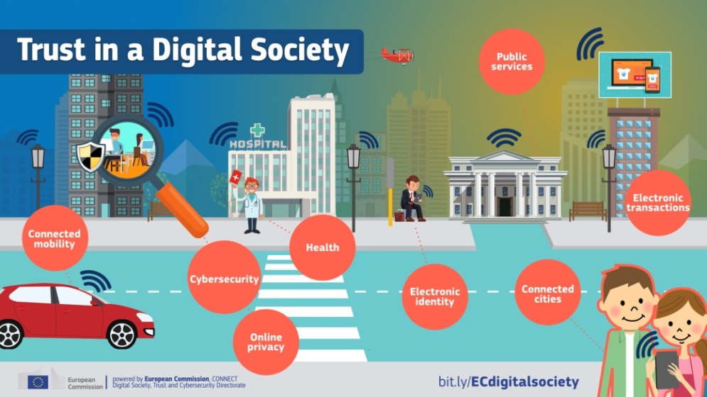
Thank you!
@eHealth_EU
@DSMeu
eHealth: https://ec.europa.eu/digital-single-market/en/policies/ehealth
R&D&I: http://ec.europa.eu/horizon-europe
EU future budget: http://ec.europa.eu/budget/mff/index_en.cfm

